Slide 1
Biosphere 2 Ocean: Optimization of Heat Exchange
Dr. Ildar Gabitov, University of Arizona
Attn: John Adams, Deputy Director, Biosphere 2
Team: Lyra Troy, Carl Solway, Sasha Sepulveda
Spring 2020 Math 485

Slide 2
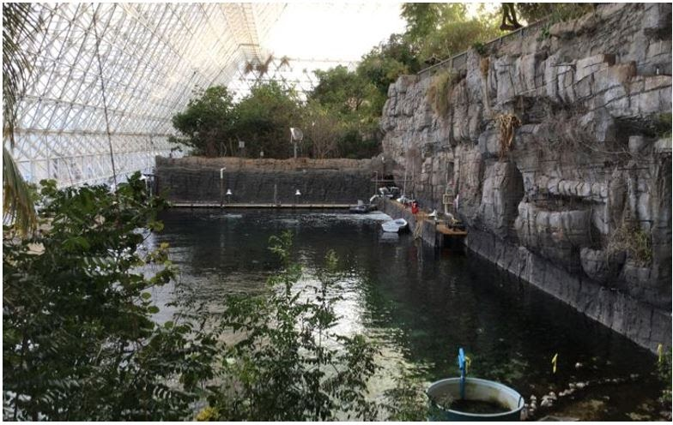
Introduction
The Biosphere 2 Ocean (B2O) allows ecologists to study coral in response to warming temperatures in a simulated ocean environment
Ecologists are not interested in energy consumption - they are interested in the temperature effects on coral
This project was created when concern rose about the high cost (over 10mil btu/day) needed to keep the B2O heated/cooled, and how to optimize the energy usage while maintaining the desired temperature of B2O

Slide 3
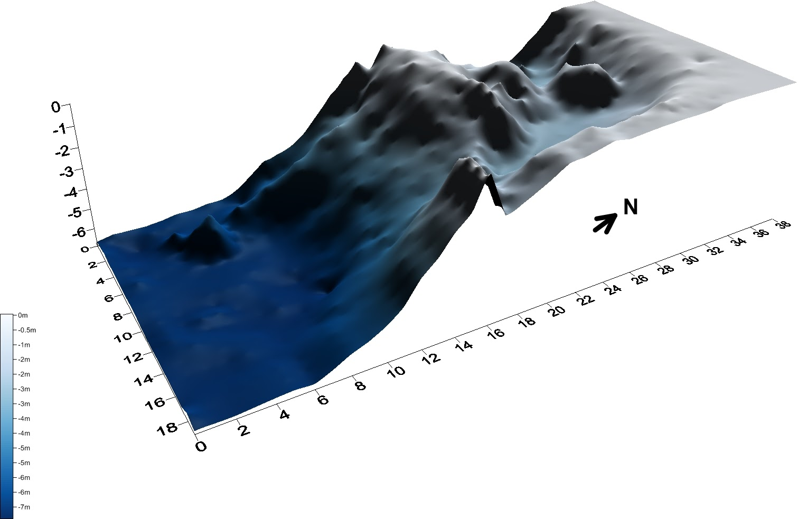
This project will oversee the modeling and optimization of heat transfer into the Biosphere 2 Ocean (B2O)
Problem Description
Throughout the day, B2O temperature varies
  Requires heated or cooled water to stay at a desired temperature
  This is manually operated by opening and closing valves through years of experience depending on temperature values
The energy consumption to heat/cool water for the B2O is very large, so putting in minimal energy while maintaining the temperature setpoint is optimal
energy

Slide 4
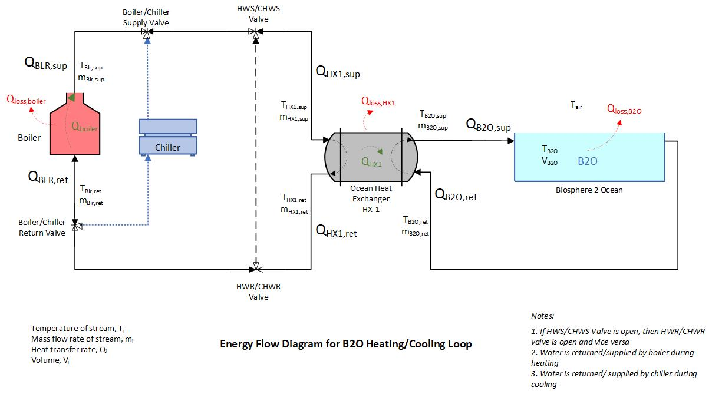
Project Description
B2O Setpoint Temperature: 75 +/- 0.2 F
B2O Volume: 676,000 gal
Inlet: 380 GPM
Author: Lyra Troy

Slide 5
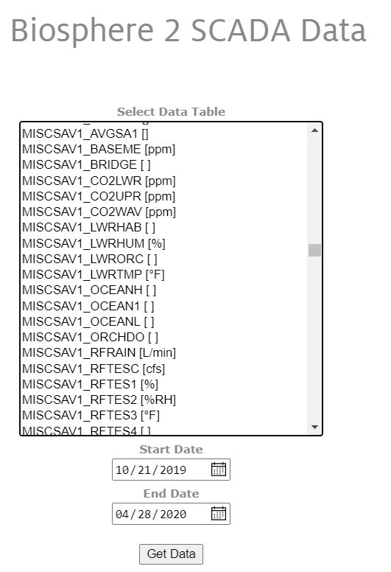
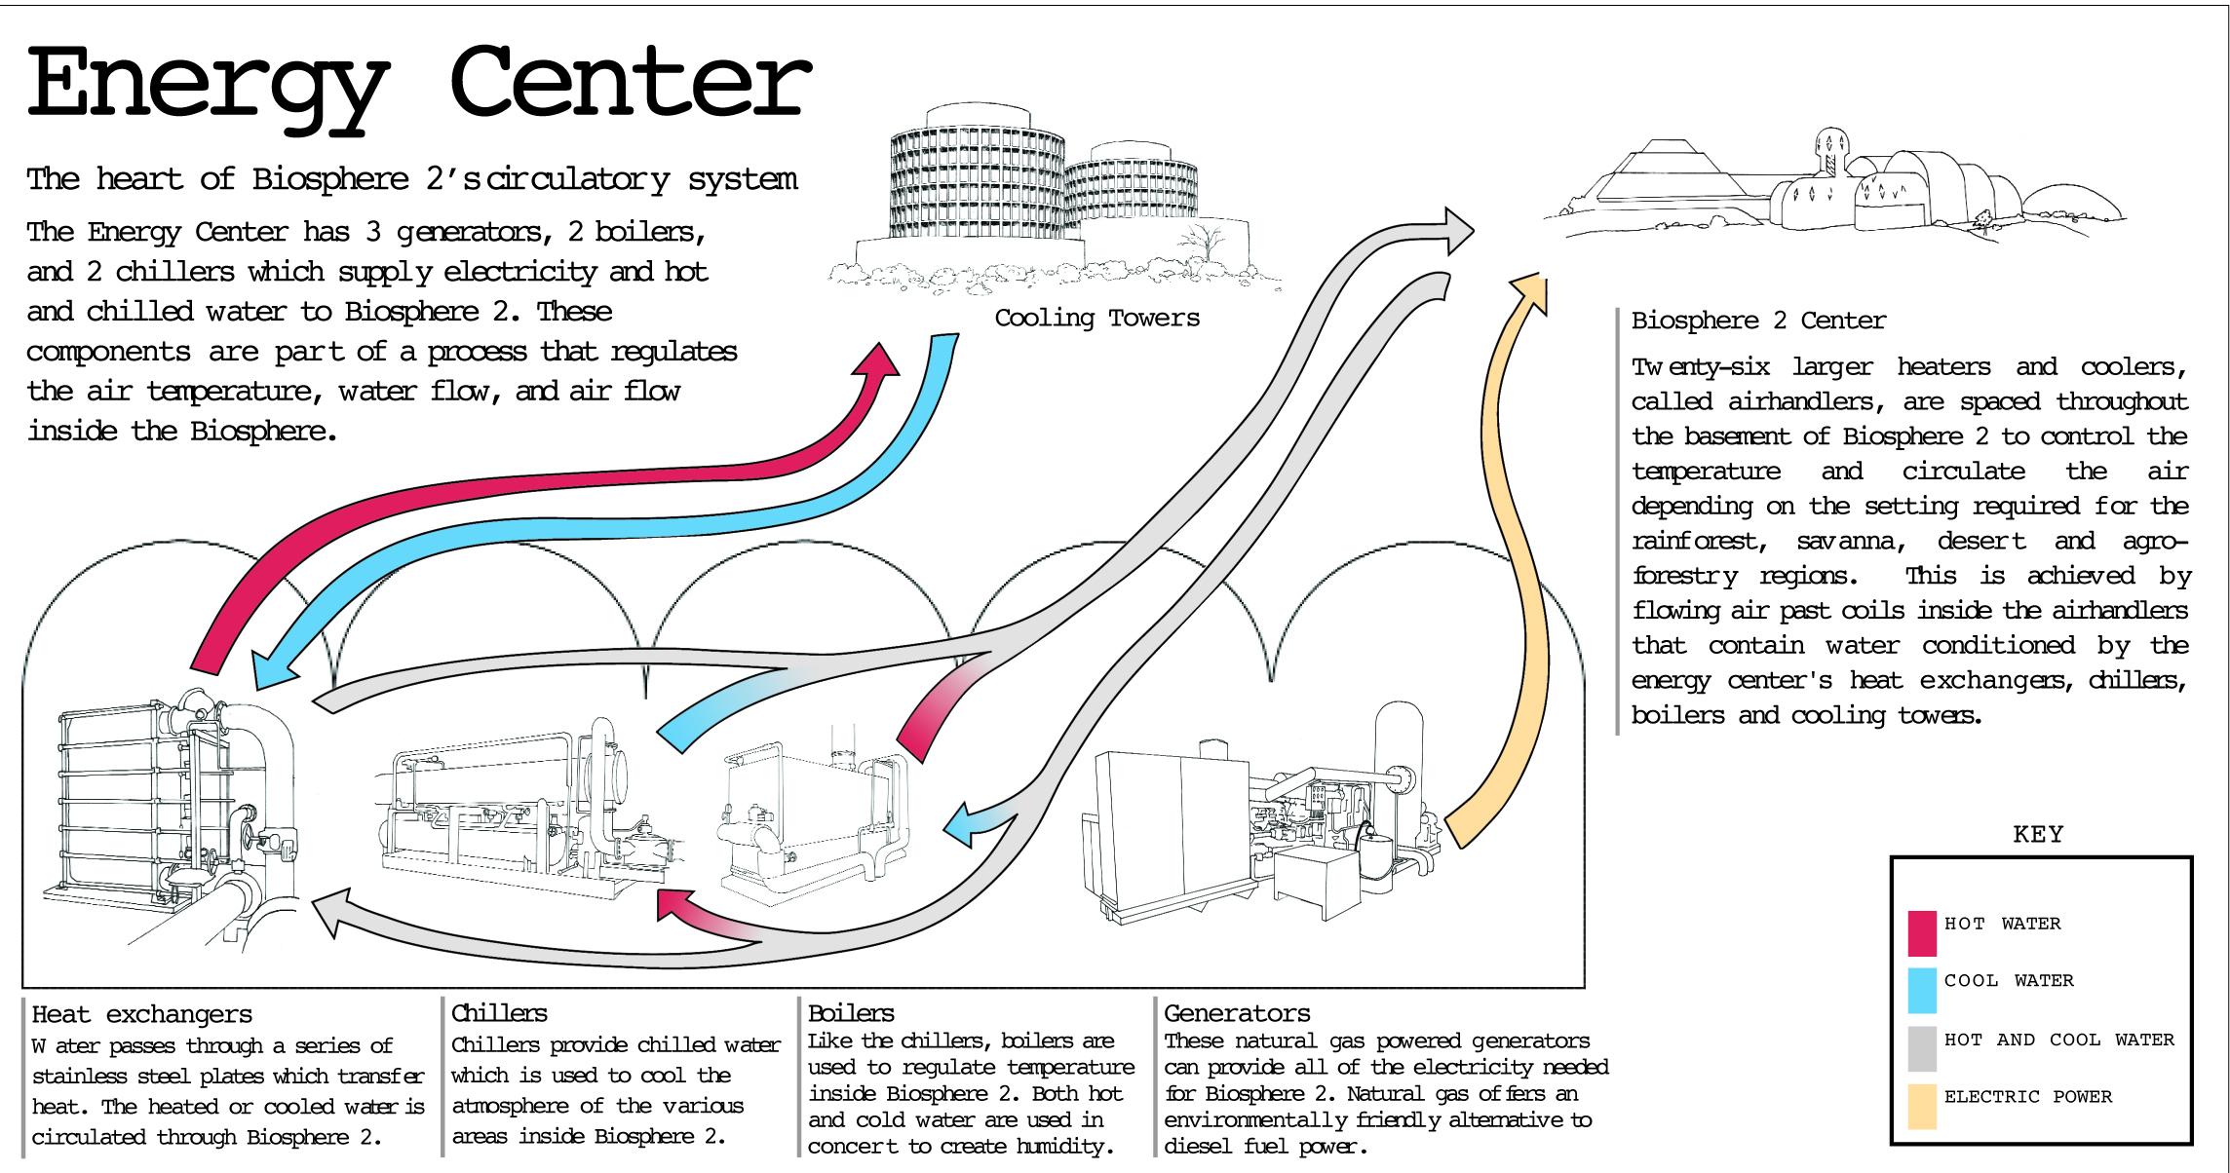
Project Challenges
No current model of energy transfer exists for B2O
Deciphering advanced P&ID’s
Matching data to sensors
Complex thermodynamics

Slide 6
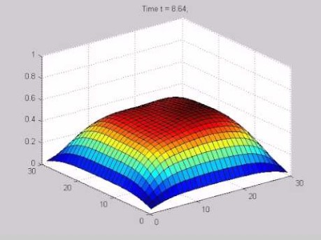
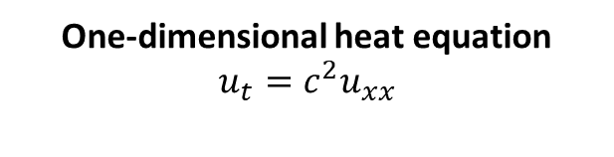
What does it mean to optimize B2O?
Background of Heat Transfer
One-dimensional heat equation
$$u_{t}=c^{2}u_{xx}$$
Can derive using Brownian and Taylor series expansions, or by conservation of energy and Fourier’s law of heat conduction, etc.
The equation above says that the rate at which something heats up is proportional to how much hotter the surroundings are
A larger difference (gradient) in temperature leads to a faster net flow of heat energy
Therefore, we should let B2O reach it’s lowest setpoint temperature, then begin heating instead of constantly keeping the supply water warm
Optimization key: It is more efficient to reheat a certain temperature than to maintain a constant temperature!

Slide 7
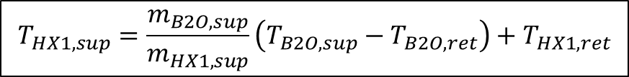
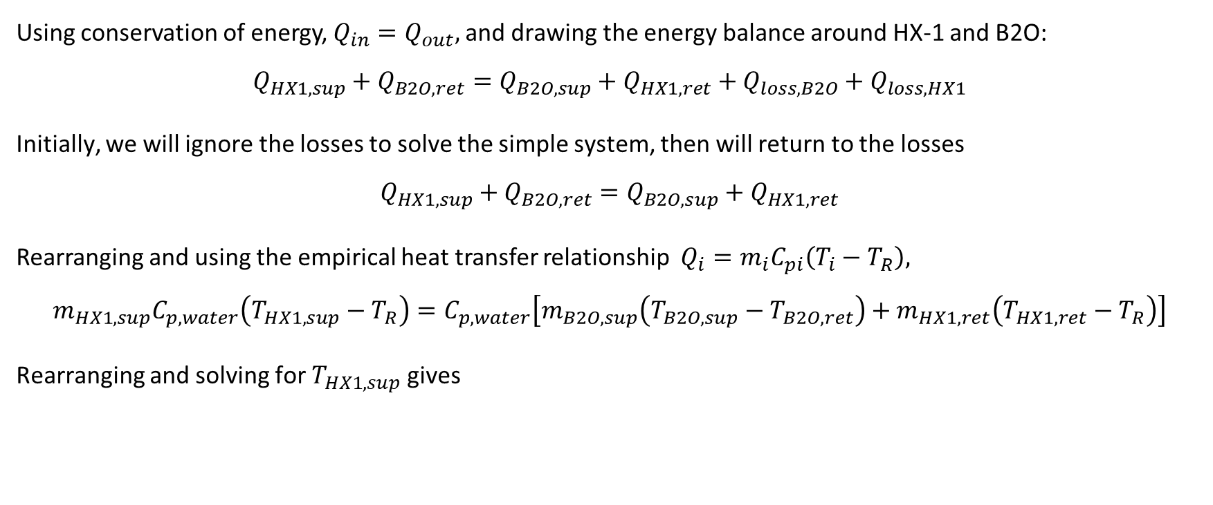
If we want to optimize the energy consumption, first we have to understand energy usage in the B2O system
Approach: Energy Balances
Using conservation of energy, $Q_{in}=Q_{out},$and drawing the energy balance around HX-1 and B2O:
$$Q_{HX1,sup}+Q_{B2O,ret}=Q_{B2O,sup}+Q_{HX1,ret}+Q_{loss,B2O}+Q_{loss,HX1}$$
Initially, we will ignore the losses to solve the simple system, then will return to the losses
$$Q_{HX1,sup}+Q_{B2O,ret}=Q_{B2O,sup}+Q_{HX1,ret}$$
Rearranging and using the empirical heat transfer relationship $Q_{i}=m_{i}C_{pi}\left(T_{i}−T_{R}\right),$
$$m_{HX1,sup}C_{p,water}\left(T_{HX1,sup}−T_{R}\right)=C_{p,water}\left[m_{B2O,sup}\left(T_{B2O,sup}−T_{B2O,ret}\right)+m_{HX1,ret}\left(T_{HX1,ret}−T_{R}\right)\right]$$
Rearranging and solving for $T_{HX1,sup}$ gives
Now that we have an equation for the incoming temperature, we can find the incoming energy to help model how much energy B2O is using
$$T_{HX1,sup}=\frac{m_{B2O,sup}}{m_{HX1,sup}}\left(T_{B2O,sup}−T_{B2O,ret}\right)+T_{HX1,ret}$$

Slide 8
Energy balance derivation matches the actual data to a correction factor, since losses were ignored
Results: Energy Balances
Since there were over 18,000 rows of data PER Excel file, we calculated for one month, which only had 3000 rows of data
HX-1 return temperature jumps from a steady 75 F to 120 F on Jan. 23rd

Slide 9
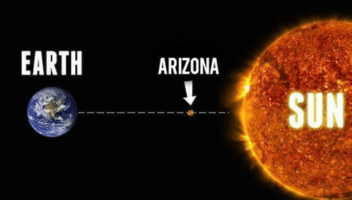
Results: Energy Losses
We ignored energy losses earlier due to their complex dependency, but they can be estimated by back-calculation (looking at difference from calculated and actual energy of system)
Ambient air temperature and other weather conditions have a large role in the system

Slide 10

Once the model was verified as best we could, we can begin to use MATLAB to simulate B2O system
Approach: MATLAB simulation
Put energy and temperature relationships into a MATLAB Graphical User Interface (GUI) program for user interaction to the B2O system
Goal is to know what flowrate or what temperature the operator should choose with changing conditions
Current simulation is very basic - relates HX-1 inlet temperature to B2O supply temperature, not the temperature of B2O itself
Estimations work best when there is little disturbance, but as complexity is added, simulation becomes more accurate
Why is this important?
  Remember: It is more efficient to reheat a certain lower temperature than to maintain a constant higher temperature!
  Goal is to allow B2O temperature to fall to its lower limit, then heat it up quickly without leaving setpoint range
  We can only do this if we know how the parameters directly affect B2O temperature in time, taking into account disturbances and delays

Slide 11
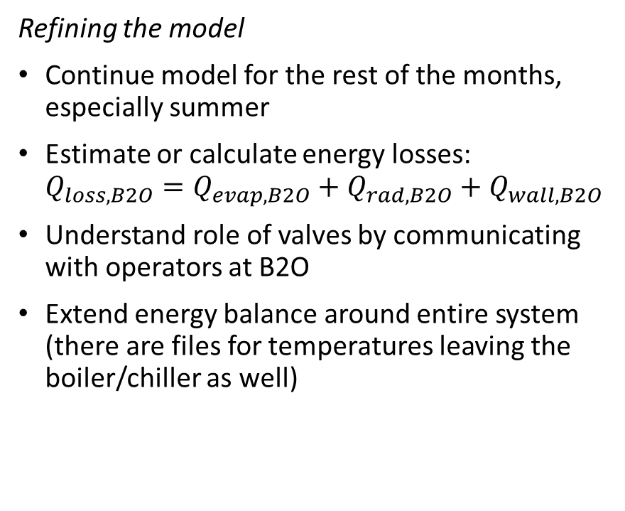
Once we understand energy usage in the B2O system, we can optimize the energy consumption.
Future Goals for Student Continuation – Good Solution
Not only does the model need to be refined with weather interactions and losses, but the MATLAB simulator needs to include disturbances.
Refining the model
Continue model for the rest of the months, especially summer
Estimate or calculate energy losses: $Q_{loss,B2O}=Q_{evap,B2O}+Q_{rad,B2O}+Q_{wall,B2O}$
Understand role of valves by communicating with operators at B2O
Extend energy balance around entire system (there are files for temperatures leaving the boiler/chiller as well)
Refining the MATLAB simulation
Learn and understand GUI script writing
Return temperatures should be removed as a slider option and should be dependent on the temperature of B2O or dependent on supply temperatures with constant Q
Final MATLAB GUI simulation should have only heat or temperature of HX-1 supply as the slider
Add disturbance

Slide 12
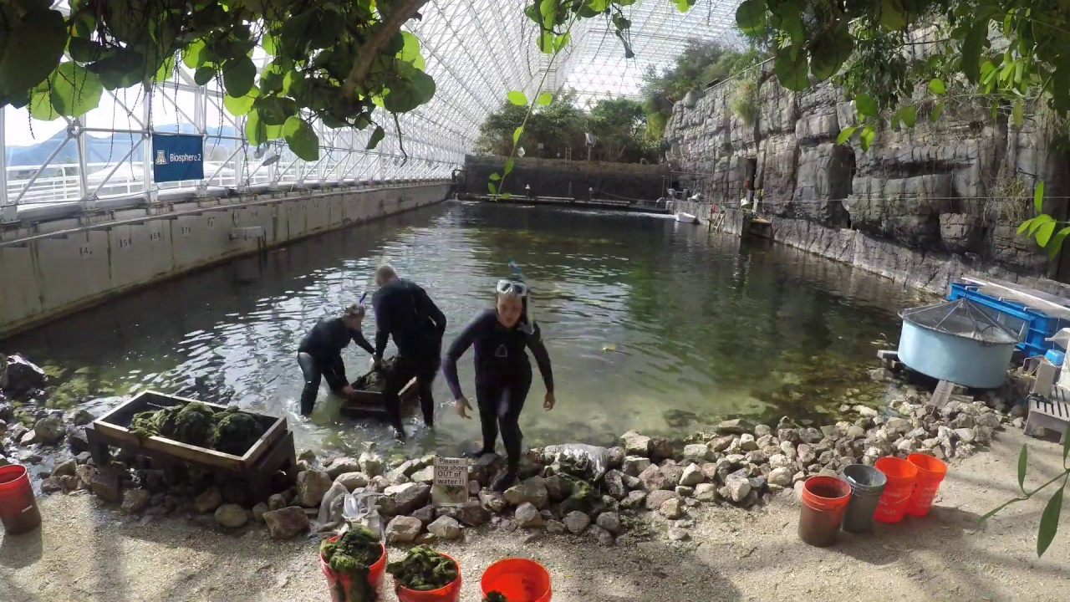
Conclusions and Recommendations
An estimation model was developed from thermodynamics
Framework for project is solidified for future groups
Optimization can be achieved through refining model and the MATLAB GUI program by adding disturbances
Recommendations:
Make a point of contact in the UA Department of Chemical and Environmental Engineering (mentors)
Investigate PID temperature controller
  Manual control results in many energy losses
  PID is the greatest form of control
  New valve and new thermocouple would be installed

Slide 13
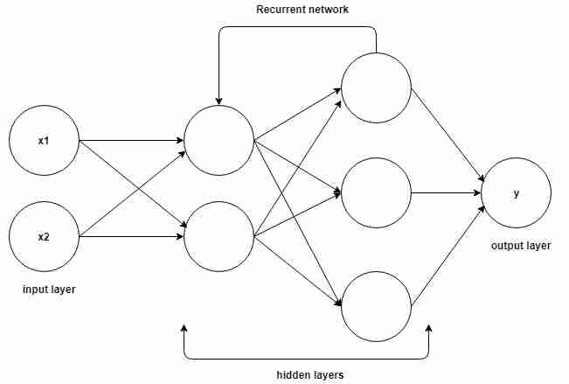
Machine Learning Applications
Recurrent Neural Network (RNN) Controller

Slide 14
Advantages
Model free
Can be optimized using real world data
Can be run year round
Optimizes for cost based on time external conditions, while keeping the pool within a set temperature range

Slide 15
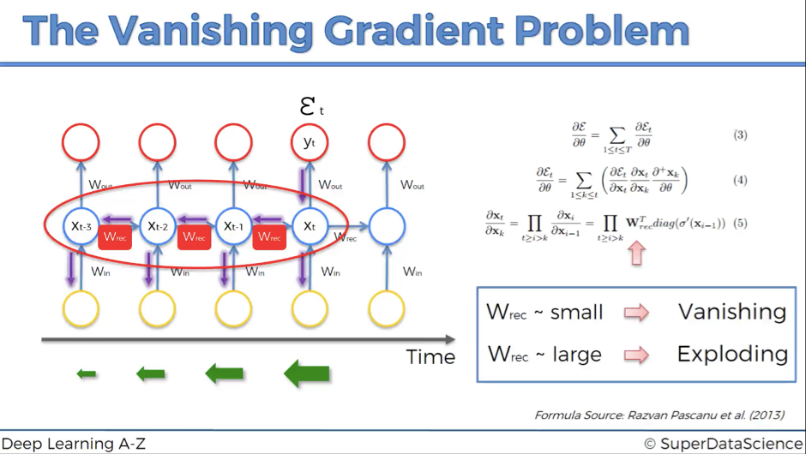
Recurrent Neural Networks
Each node of each layer is connected to all the nodes of the subsequent and previous layers
Exploding/vanishing gradient problem
Because networks are unrolled through time, they can quickly become bloated and unwieldy

Slide 16
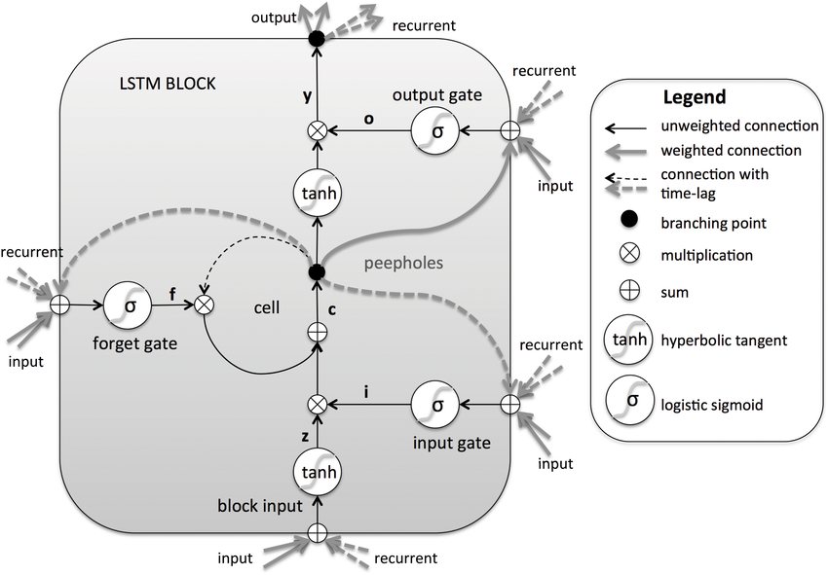
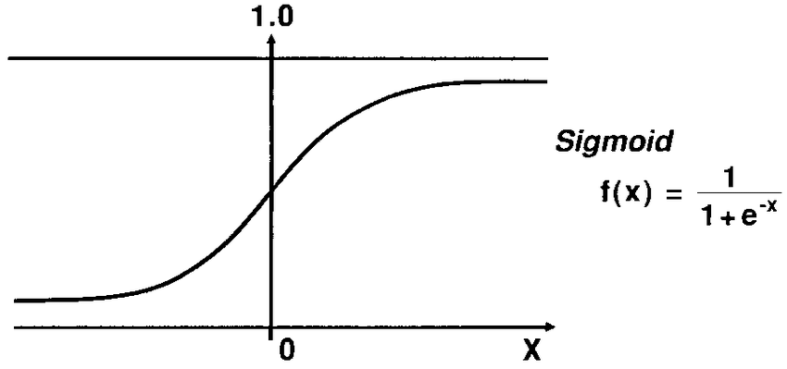
Solution: Long-Short Term Memory Networks (LSTM Networks)
Hyperbolic tangent normalizes values between -1 and 1
Sigmoid function normalizes values between 0 and 1
The cell state is updated at each time step based off information modulated by the various gates

Slide 17
Heat Pump Thermostat Control
2017 Article, Wang et al
Used an LSTM RNN controller to optimize a thermal zone for cost while maintaining thermal comfort
Leveraged an Energy Plus simulation in conjunction with a sophisticated actor critic method in order to provide real time training feedback for the network
Reported an improvement in energy efficiency of up to 2.5% when compared to other traditional controller setups (on/off controllers and PID controllers)

Slide 18
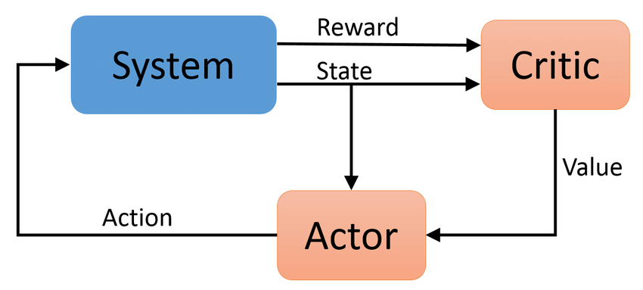
Actor Critic Method
Actors action state mapping and critics state value function are both approximated by LSTM networks
The critic computes a single value at each step that acts as a baseline in the policy gradient update

Slide 19
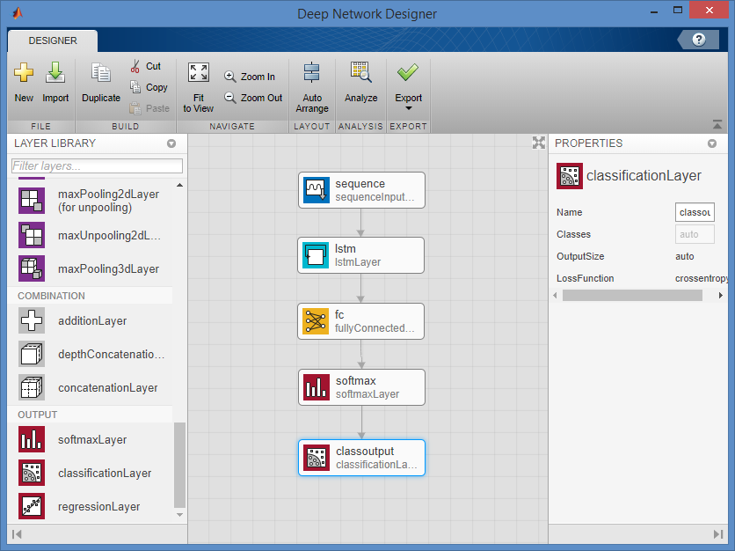
Basic LSTM and Training Data
Collated B20 data into a 10x1000 table
Created output array of possible temperatures for every time step

Slide 20
Challenges and Next Steps
Training a basic LSTM requires either prior knowledge of an optimal solution (i.e. identification/classification problems), or feedback (simulation)
Adequately modeling fluids thermodynamically

Slide 21
References
Biosphere 2 Ocean Tank Renovation. Ocean Tank Renovation – Piping and Instrumentation Diagram. Sheets LSO.41, LSO.45. Provided by John Adams at Biosphere 2.
Fogler, H. Scott., and Gürmen M. Nihat. Elements of Chemical Reaction Engineering. PHI, 2013.
Language Identification in Short Utterances Using Long Short-Term Memory (LSTM) Recurrent Neural Networks - Scientific Figure on ResearchGate. Available from: https://www.researchgate.net/figure/Long-Short-Term- Memory-recurrent-neural-network-architecture-A-single-memory-block-is_fig8_292303547 [accessed 30 Apr, 2020]
Levenspiel, Octave. Engineering Flow and Heat Exchange. Springer US, 2014.
Seborg, D. E., et al. Process Dynamics and Control. Wiley, 2004.
Team, SuperDataScience. “Recurrent Neural Networks (RNN) - The Vanishing Gradient Problem.” SuperDataScience, 22 Aug. 2018, www.superdatascience.com/blogs/recurrent-neural-networks-rnn-the-vanishing-gradient-problem.
University of Arizona Biosphere 2 Ocean Renovation – Heat Exchanger Package. Mechanical Controls, Sequence of Operations and Points List. Sheet Number MI001. M3PN 180158.502. Provided by John Adams at Biosphere 2.
Wang, Yuan, et al. “A Long-Short Term Memory Recurrent Neural Network Based Reinforcement Learning Controller for Office Heating Ventilation and Air Conditioning Systems”. MDPI. Chemical Engineering Department, University of Alberta, Edmonton, Canada, 18 August 2017.
Zuccari, F, et al. “Energy Analysis of Swimming Pools for Sports Activities: Cost Effective Solutions for Efficiency Improvement.” Energy Procedia, vol. 126, 2017, pp. 123–130., doi:10.1016/j.egypro.2017.08.131.

