Slide 1
The Use of Genealogical Trees in Predicting Virus Mutation
By Dominique Hughes, Nur Izzati Johari, and Ling Yang
Mentor: Nicole Fider

Slide 2
Brief Background
Vaccines use predictions of future virus mutations
Predictions require knowledge about what in the genetic code makes a virus “fit”
We do not have this information for many viruses, which means it can be difficult to create vaccines
Image Adapted from “Flu Vaccine Selections Suggest This Year’s Shot May Be Off the Mark,” by Branswell, 2019, Retrieved from https://www.scientificamerican.com/article/flu-vaccine-selections-suggest-this-years-shot-may-be-off-the-mark/
Notes:
We started our last presentation asking who got their flu shot. This was to introduce the topic of virus mutation and vaccine prediction. Scientists predict the most likely viruses to mutate in the upcoming year in order to create the vaccines that we get. These predictions require an in depth understanding of what makes a virus “fit”. The “fitness” of a virus is the likelihood that it will continue to survive in a given environment. Some mutations can make a virus more fit and some can make it less fit - however, it can be hard to determine what genetic components translate into a fit virus strain. As a result, it can be difficult to predict virus mutations and create vaccines for viruses that we do not know much about.

Slide 3
Brief Background
Neher et al. (2014) suggested a model to use genealogical trees to predict virus mutations
They use the Inferred Fitness Model (Equation (1)) to determine the most likely progenitor of future virus strains by looking at the shape of the tree
They claimed this method had a high success rate for predicting the virus, because it produced similar results to the secondary model
Notes:
Neher, Russell and Shraiman have developed a more general method to predict fitness from virus genetic sequences by first creating a ‘family tree’ for a virus population. The genealogical trees of the virus are constructed by recording the different strains of the virus at different times and using those samples to construct a tree which shows likely ancestry patterns connecting the observed strains. They then can use the shape of the tree and the branching of the tree to rank which virus strain is the most fit and therefore the most likely to be the progenitor of the next year’s virus. This method is based on the assumption that a more fit virus will have more branching, as it is likely to come from a higher fitness strain and then will produce a similarly high fitness strain. This method is called the Inferred Fitness Model. The Neher et al. paper claims that this method has a high success rate for predicting the virus, as it had similar results to its secondary model.

Slide 4
What Was Planned
We previously planned to:
Recreate the experiment with new flu data
Test a new method of making the genealogical tree to see if it improves method
Improve secondary method provided by the authors
Major challenge:
The code provided by the authors is so complex, that it would be incredibly difficult to change it and have it still be functional
As a result, it was impossible for us to really try to improve the existing model
Notes:
Our original plan was to first recreate the experiment. The database where they got their influenza data includes information about other types of influenza, which we wanted to use in order to confirm that the models work. Additionally, we had hoped to further this knowledge base by attempting a different method of recreating the genealogical tree and then testing the models again on this new tree to see if it improves or decreases the accuracy of their predictions. If we had time, we would have looked into improving the secondary model so that it was as accurate as the inferred fitness model. Unfortunately, we immediately ran into a major challenge in our plans: the code provided by the authors used in executing the inferred fitness model was so complex, that there was no way for us to change it and still have it be functional (honestly, it took us quite a while to figure out how it worked unmodified). As a result, it would have been impossible for us to change the model in any way and still be able to compute the data, so we were unable to even approach those second two project goals.

Slide 5
New Plan
Our project has become solely a validation study of the Neher et al. (2014) experiment
We attempted to recreate the experiment with new flu data, and then tested the accuracy of the Inferred Fitness Model provided by the authors
This was to determine the accuracy rate of the Inferred Fitness Model (i.e. how many times it accurately predicted a virus progenitor given multiple data sets)
Notes:
Instead, we focused solely on validating the existing study. We used the code that they provided on completely new flu data (that was narrowed down according to similar parameters as the original study). This flu data was grouped, and the accuracy of the Inferred Fitness Model was tested in each group. This was done by first predicting a progenitor virus strain, and the determining if this virus strain actually produced strains in future years. This was to determine the accuracy of the Inferred Fitness Model, and validate the authors claim that this method is successful in predicting virus evolution.

Slide 6
Challenges to the New Plan
First challenge: using the code provided by the authors to achieve the rankings of different virus strains (reminder: top ranked strain is considered most likely progenitor)
Additionally, the authors mention editing a portion of the code in specific situations, but not HOW it was edited
Second challenge: Retrieving large sets of influenza virus data to work with from the Influenza Research Database (IRD)
Third challenge: figuring out a way to determine if the top ranked virus strain was indeed a progenitor for future viruses
Notes:
As we stated previously, one major challenge was using the code provided from the authors, as it was incredibly complex. Additionally, the authors mention that they edited the code to account for certain conditions (such as small sample size) when they were conducting their experiment, however, they failed to mention how they edited their code, so we could only use the code provided, even on small samples. Our next challenge was finding and working with the virus data retrieved from the Influenza Research Database. The influenza database has thousands of records on virus strains, so we first had to determine parameters to use in finding the virus strains; we then had to figure out how to use the databases resources in order to compile this data into a file that could be read by the code. The third challenge as figuring out how to determine if the model was indeed making accurate predictions. The Neher et al. study validated the results of the primary model with the secondary model, but not with real data. We created our own method of validating the predictions made by the inferred fitness model, which we will explain in the next couple of slides.

Slide 7
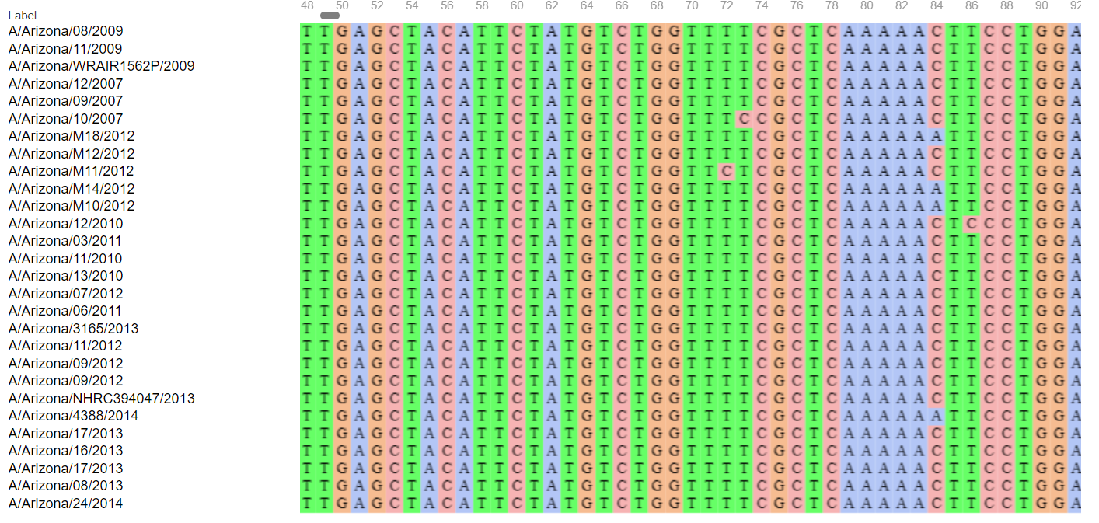
Methods
We retrieved specifically organized files of AH3N2 virus data from the years 1968-2014 in humans for 40 different states from the IRD.
Notes:
First, we used the influenza database to find AH3N2 influenza strains from the years 1968 to 2014, in humans. We looked specifically at a portion of the genome, the HA portion of the genome, which is what Neher et al. also looked at when comparing virus data. This portion was then aligned, meaning that the genetic sequence of each strain was lined up so that it's place in the genome was lined up with the same portion of the genome as all of the other virus strains.

Slide 8
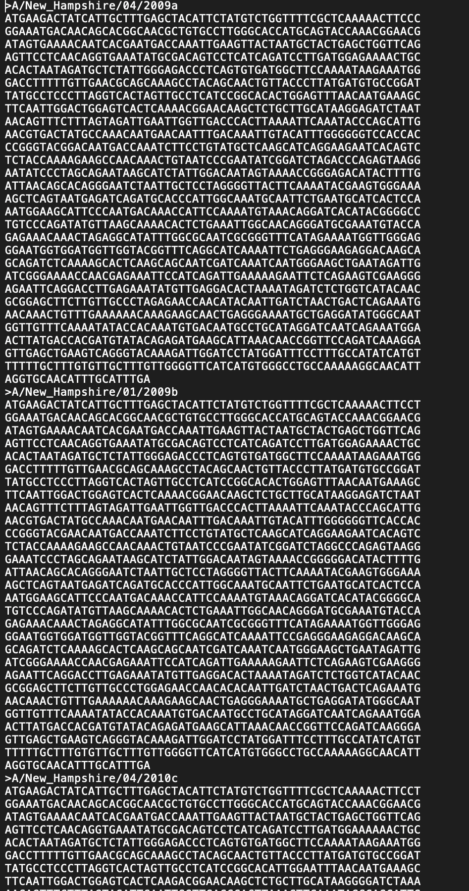
Methods
These files were then individually edited in order to run them through the Inferred Fitness code.
Notes:
Once the aligned data file was retrieved from the database, it required editing before running them through the Inferred Fitness Code. Each strain had be considered unique, meaning that the names of each strain were edited so that they could the code would know that they were different and compare them accordingly.

Slide 9
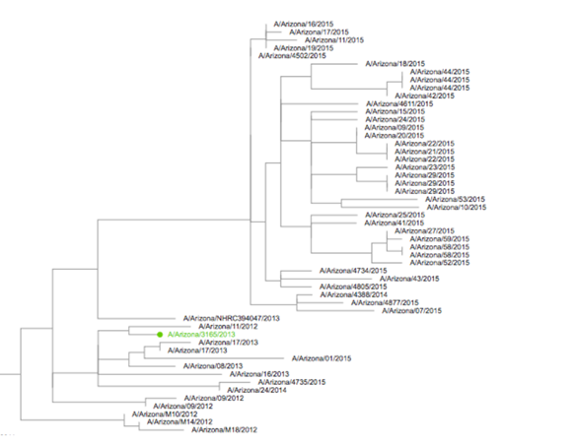
Methods
Once the rankings were retrieved, we used the IRD to create phylogenetic genealogical trees for AH3N2 virus data from the years 1968-2015 in humans for the same 40 states.
The genealogical distance between the top ranked virus strain and the 2015 strains was recorded.
Notes:
Finally, we used the influenza database to retrieve the same type of influenza data as before, except now we extended the data collection to the year 2015. This would allow us to determine if the top ranked virus strain (here it is highlighted in green) was indeed a progenitor for future virus strains. This was done by determining what we termed the “genealogical distance” between the top ranked strains and the 2015 strains. This example shows a poor prediction, as the top ranked strains is multiple generations away from connection with the 2015 strains.

Slide 10
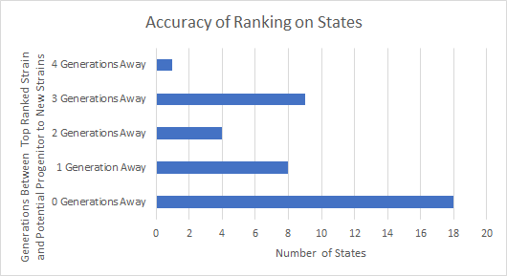
Results
High accuracy predictions (0 or 1 generations away) for 65% of the states
Medium accuracy predictions (2 generations away) for 10% of the states
Low accuracy predictions (3 or 4 generations away) for 25% of the states
Notes:
Here are the overall results from our experiment. Of the 40 states, 26 of them had a high accuracy prediction from the inferred fitness model (meaning that the genealogical distance between the prediction and the 2015 strains was very small). 4 of the states had a medium accuracy prediction (meaning that the genealogical distance was not as small as it could be, but also not completely inaccurate). 10 of the states had a low accuracy prediction (meaning that the genealogical distances was large, and the highest ranked strain was very clearly not a progenitor of the 2015 virus strains).

Slide 11
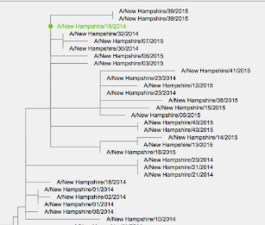
This is a close-up of the New Hampshire phylogenetic tree. The top ranked strain is highlighted in green. This is high accuracy prediction, as the most likely progenitor is very close genealogically to the 2015 strains.
Notes:
This is a close up of the New Hampshire phylogenetic tree. If you’ll remember from a couple slides ago, we showed you all a poor prediction from the Inferred fitness model in that the highest ranked strain was not a direct progenitor to the 2015 strains, but was instead 3 generations away from the closest progenitor strand. This picture demonstrates a high accuracy prediction. As you can see, the highlighted strand is a direct and immediate progenitor of the 2015 strands for New Hampshire.

Slide 12
Conclusion
The Inferred Fitness Model is fairly accurate.
Reminder: we could not completely reproduce the original experimental conditions, so this may not be an entirely accurate assessment of the model.
It is likely this method could be used to predict virus mutations in real life settings, especially with larger data sets.
Notes:
The conclusion of our experiment is that the inferred fitness model is fairly accurate (about 65%). We could not completely reproduce the original experimental settings, so the model may indeed be more accurate if it could be edited as the authors did in specific settings. The program might have had improved accuracy if we had been able to edit it to work more functionally on smaller data sets. One comment that I will make on the results is that, when the prediction was wrong, it was VERY clear that it was wrong, even before the tree was made (sometimes the most likely progenitor would be a strand from 2013 or even 2012). If you were to use this in a real life setting, it would be clear whether or not you were getting a possible progenitor; scientists could use their own judgment about whether or not a given prediction should be trusted.

Slide 13
Limitations of the Research Model
The phylogenetic tree is theoretical; while it is likely an accurate account of virus mutations, it is not a confirmed account of virus mutations.
We only tested one of the models provided; the secondary model was used by the authors to confirm their primary model, but we did not get the chance to test the secondary model.
Some states had too little or too much data for us to be able to include (hence, 40 out of 50 states tested).
Of the states included, there was a lot of variability in the amount of data available to us, which affects how accurate the model and the phylogenetic tree can be.
Notes:
Some final thoughts on our project: the phylogenetic tree is a theoretical method of determining virus mutations. While it is a likely account of how the virus strains are related to each other, it is not without it's own possibility for error. We only tested one of the models provided; a possible future direction of this project would be to test the accuracy of the secondary model. We were not able to include all 50 states in our research (and actually, Neher et al. actually uses data not only from the United States, but North America generally). This is because some states had too much or too little data for us to use when creating an appropriate file on the database, or running it through the code. Finally, there was a lot of variability in the amount of data available to us for each state, which can affect how accurate the model and the tree can be (for both, more data generally leads to more accuracy because there is more data to use as parameters). This may account for some of the low accuracy predictions.

Slide 14
Acknowledgement
Thank you to Neher et al. for their excellent works, which we have used as the basis of our project.
Thank you to our mentor Nicole Fider, for your help in all aspects of this project.
Lastly, thank you to Dr. Gabitov for your ideas, commentary and guidance.

Slide 15
References
Branswell, H. (2019, September 30). Flu Vaccine Selections Suggest This Year's Shot May Be Off the Mark. Retrieved from https://www.scientificamerican.com/article/flu-vaccine-selections-suggest-this-years-shot-may-be-off-the-mark/
Influenza Research Database - Influenza genome database with visualization and analysis tools. (2020, March 22). Retrieved from https://www.fludb.org/brc/home.spg?decorator=influenza
Neher, R. A., Russell, C. A., & Shraiman, B. I. (2014). Predicting evolution from the shape of genealogical trees. ELife, 3. doi: 10.7554/elife.03568
Price, M. N. (n.d.). FastTree. Retrieved from http://www.microbesonline.org/fasttree/
Rneher. (2015, May 7). rneher/FitnessInference. Retrieved from https://github.com/rneher/FitnessInference
Notes:
Thank you for listening to our presentation! Are there any questions?

