Slide 1
Analysis of the U.S. Stock Market
Taylor Agarwal, Henk Quelle, Cooper Ryan

Slide 2
Outline
Project Overview
Methodology
Scientific Challenges
Results
Potential Applications

Slide 3
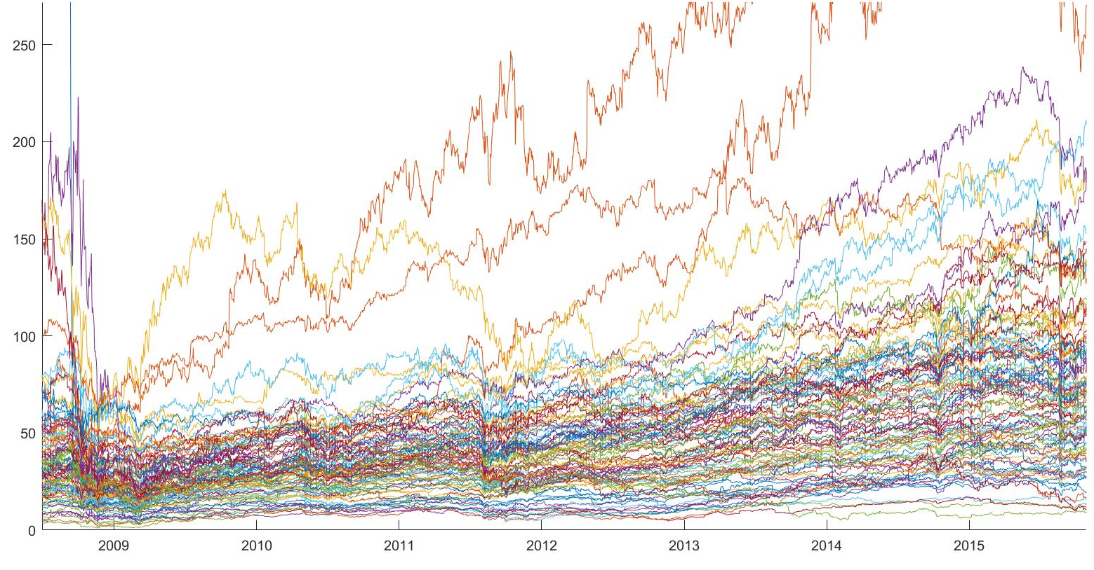
Project Overview
We constructed a novel tool to form stock groupings based on weights garnered from Principal Component Analysis
Papers showed how to use PCA and how it relates to stocks [1] but none really had the same idea of using it to group them into portfolios
We made a programmable tool that knows which parts of the market move together

Slide 4
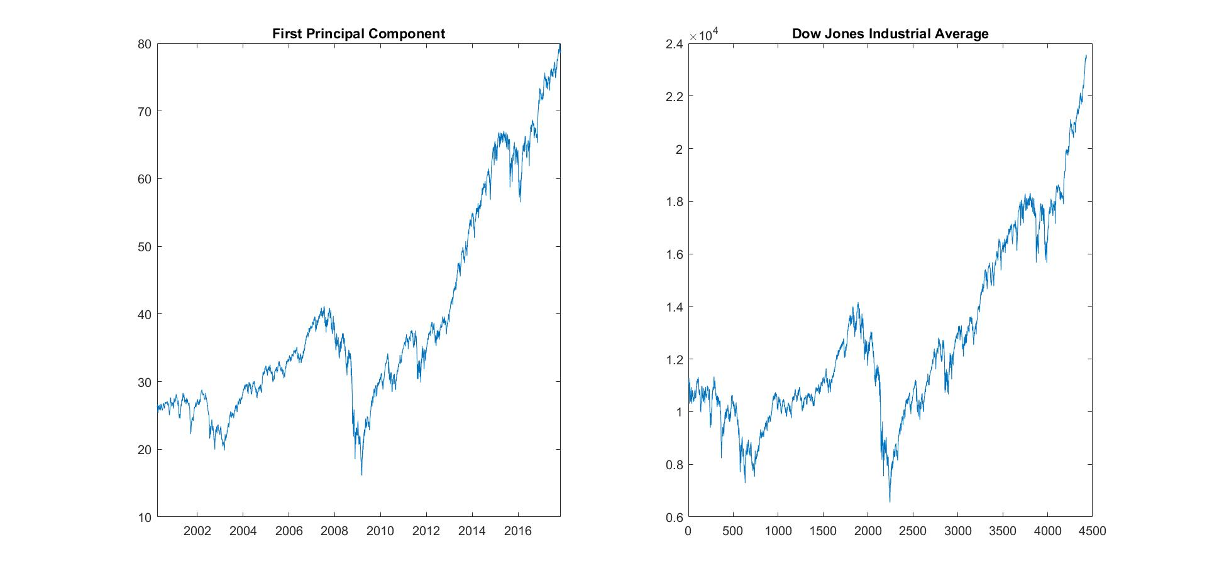
We were able to successfully group seemingly unrelated stocks that had almost identical fluctuations based on the found eigenstocks
We were able to successfully model the Dow Jones Industrial Average, which demonstrates the validity of our approach
We were able to successfully observe the effects of catastrophes on grouped stocks

Slide 5
Statement of Problem
How can we predict increases and decreases in the values of individual stocks?

Slide 6
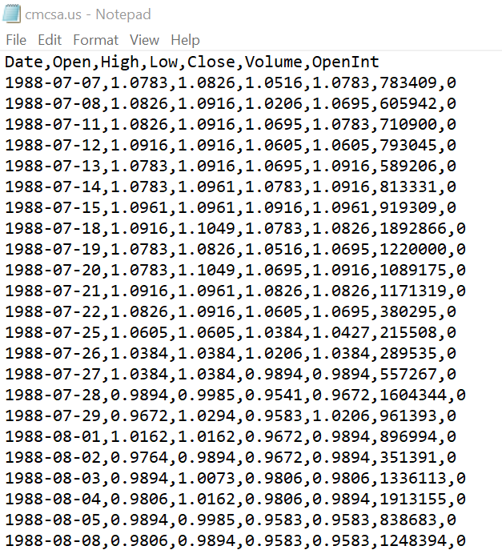
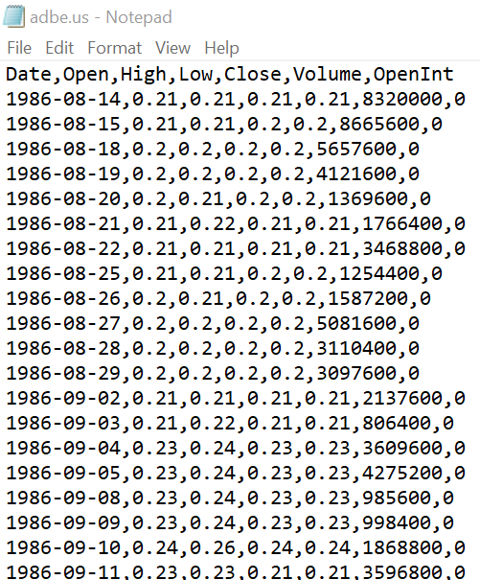
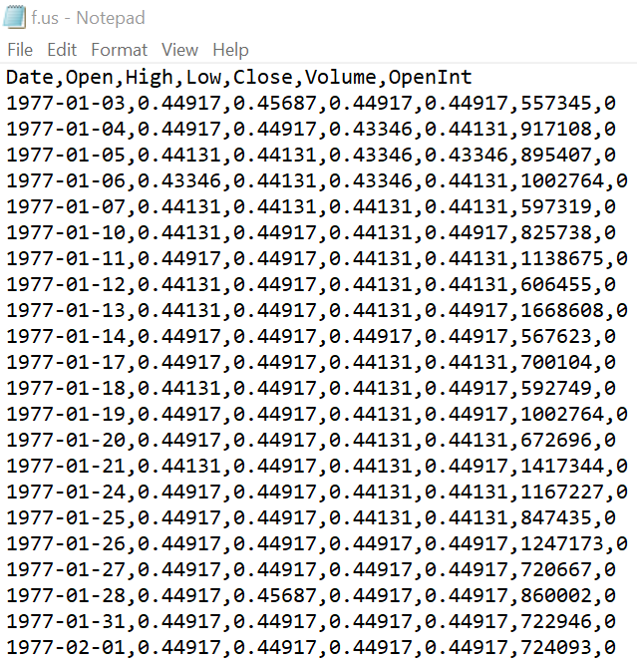
Methodology
We identified a large dataset with 7195 stocks with their values for each day between 1960 and 2017

Slide 7
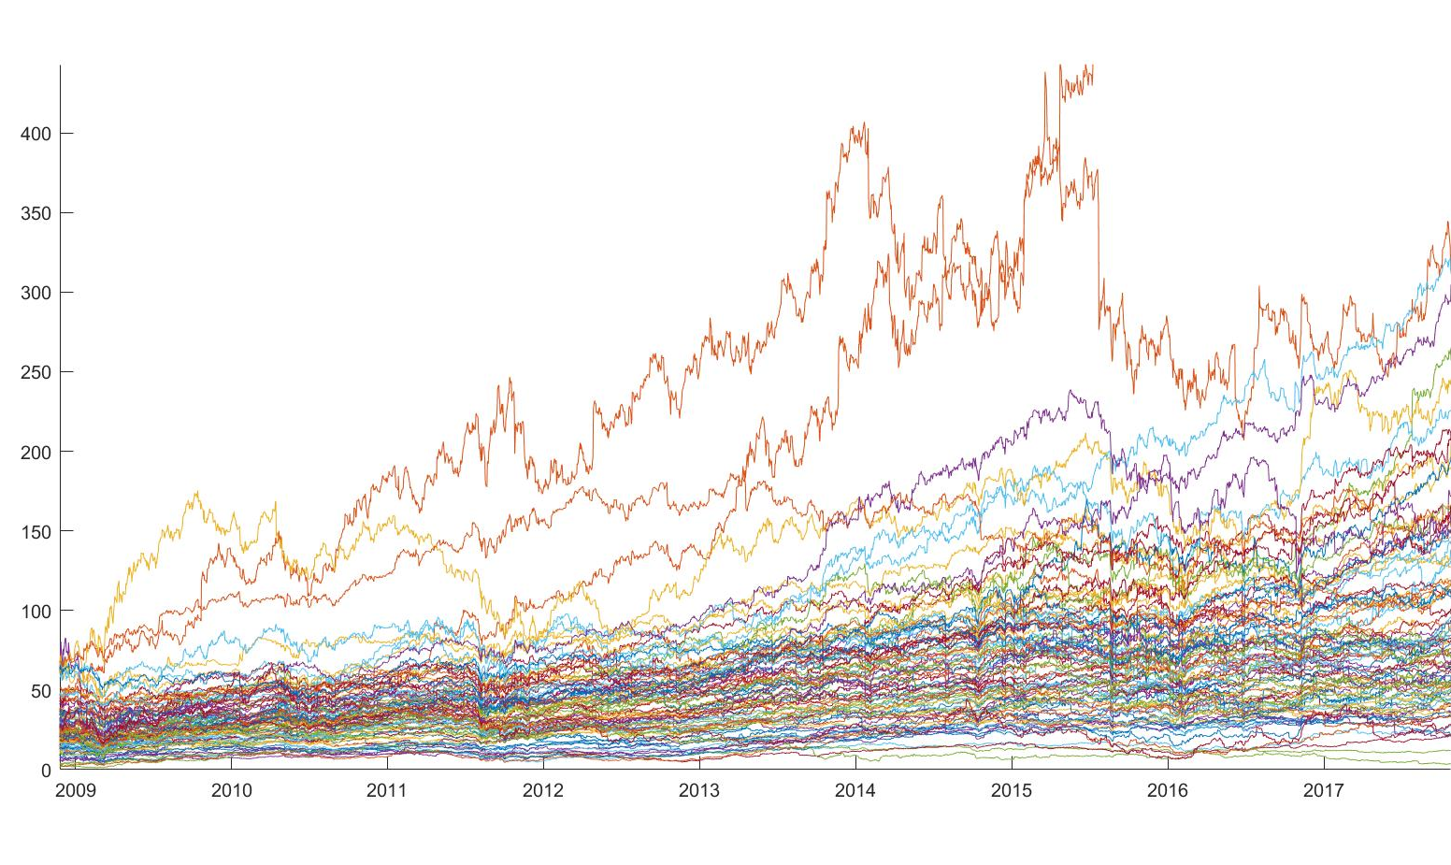
For the majority of our analyses, we used a 100 stock subset of this large set, comprised of “Big Name” stocks that have been public since 2001, such as Walmart, Amazon, Ford, and many others

Slide 8
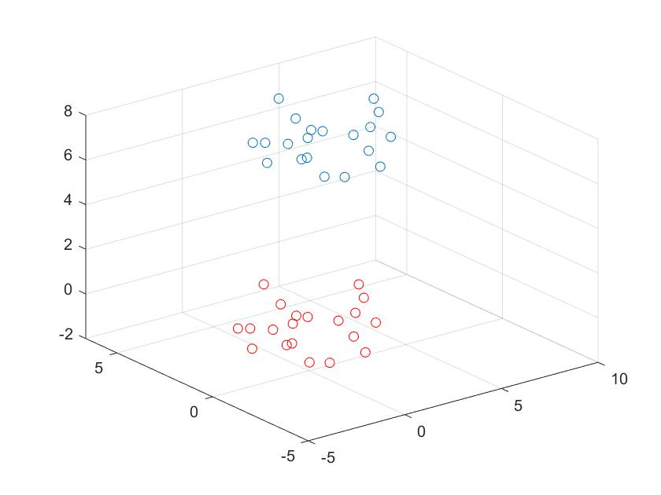
We performed Principal Component Analysis on the data, which consists of several steps:
Step 1: Shift the data, A, by the average stock μ
Original Data
Shifted Data

Slide 9
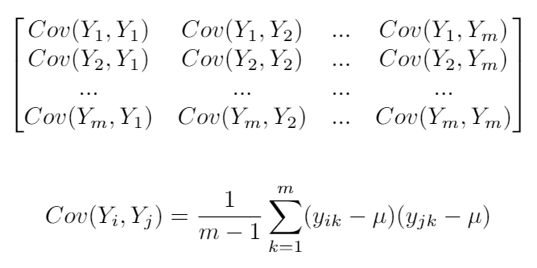
We performed Principal Component Analysis on the data, which consists of several steps:
Step 2: Compute the Covariance Matrix, C

Slide 10
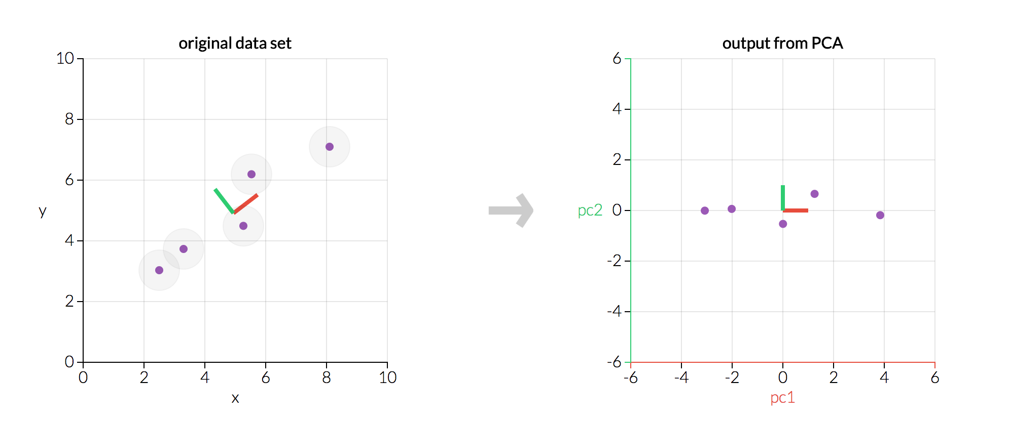
We performed Principal Component Analysis on the data, which consists of several steps:
Step 3: Find the eigenvectors and associated eigenvalues of C
Figure 1

Slide 11
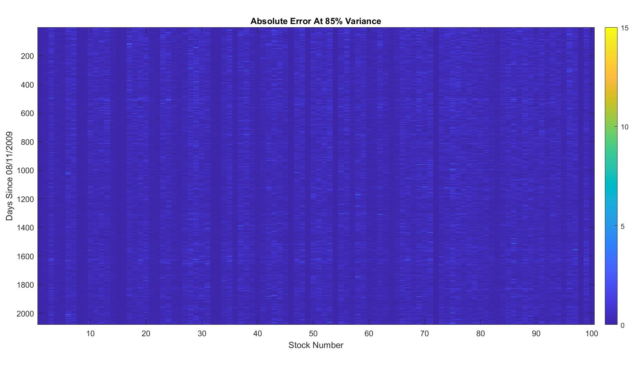
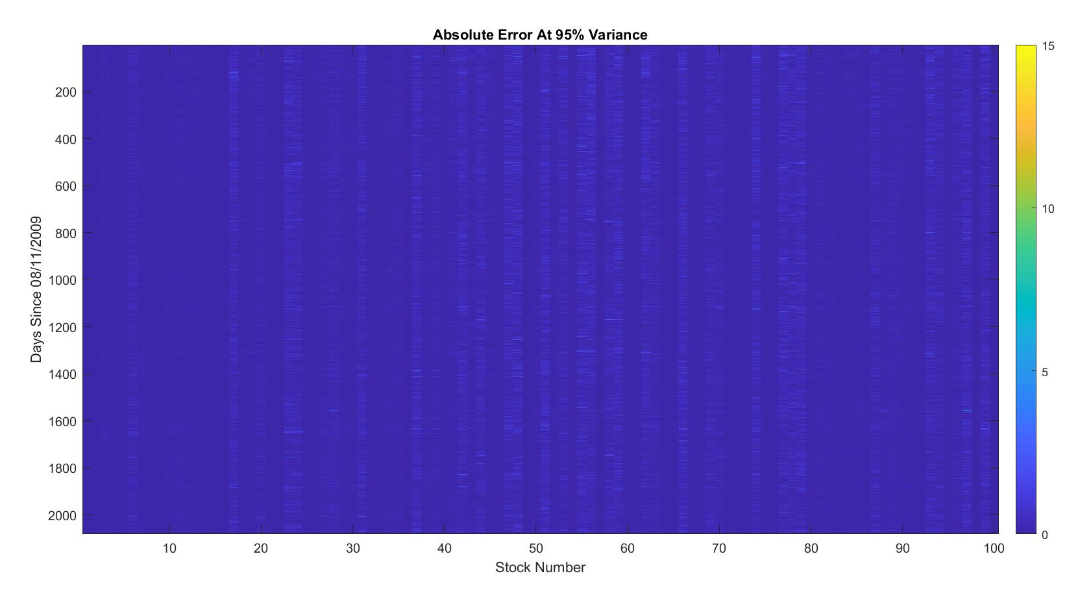
We selected a subset of these eigenvectors that explained 90% of the variance in our data
PoV
85%
90%
95%
Reduct
42.40%
30.88%
16.20%

Slide 12
We can then express each original stock as a linear combination of the average stock and the eigenstocks, v₁ , …, v_{k}
We find the largest weight w_{i} and consider stock X to be in the i-th portfolio with other stocks that belong to that portfolio
AAPL
AMZN
CSCO
ADBE
. . .
Portfolio 1
Portfolio k

Slide 13
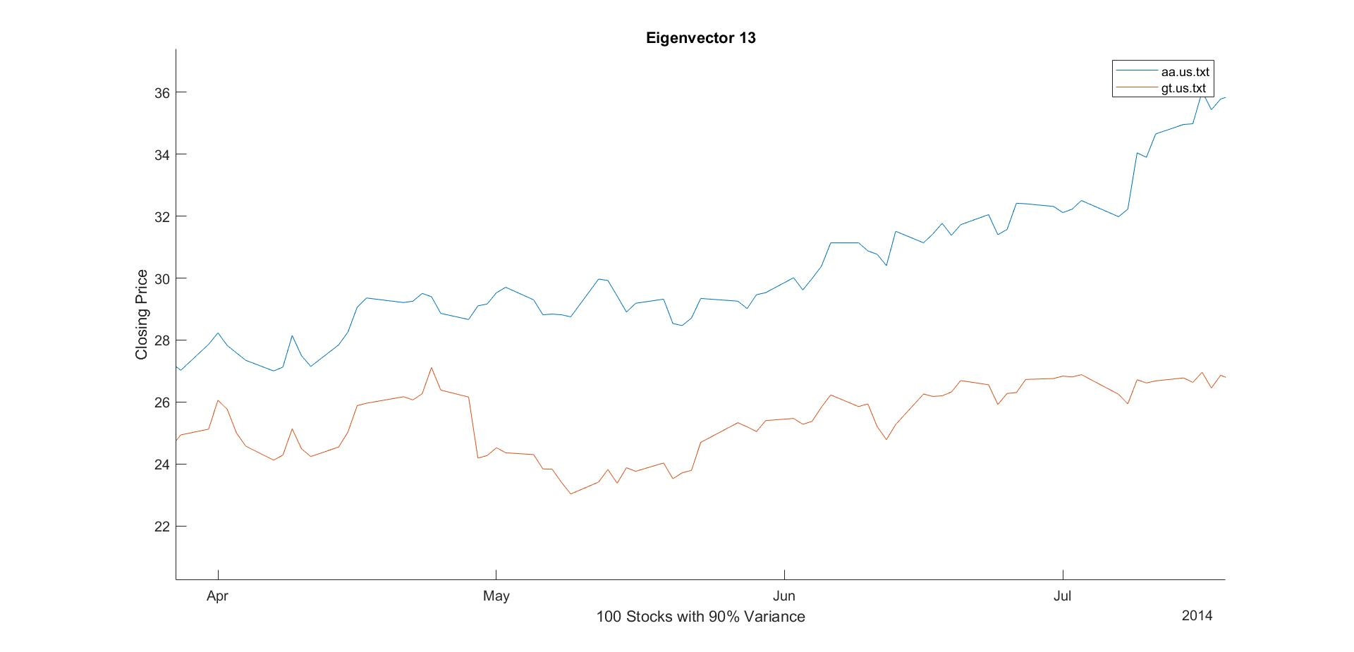
What Did This Do?
Stocks belonging to the same portfolio will have similar variance, meaning that these stocks will increase and decrease at the same time
The amount by which each stock increases and decreases is not identical, but the timing is identical, within a small margin of error

Slide 14
Analyses Our Tool Performs
In one analysis, the tool explores how the eigenstocks themselves were related to the overall trends of the stock market
In another analysis, the tool forms portfolios and displays them to see interesting relationships between seemingly unrelated stocks
In the last analysis, the tool uses the 100 stock subset as a training set, then projected a stock outside the subset that experienced a catastrophe onto the eigenstocks, and observed it in the portfolio of its nearest neighbor to see if they experienced similar declines in value

Slide 15
Scientific Challenges
Computing Power of MATLAB does not allow for large enough matrices to group the whole market, had to develop a workaround for this
Figure 2

Slide 16
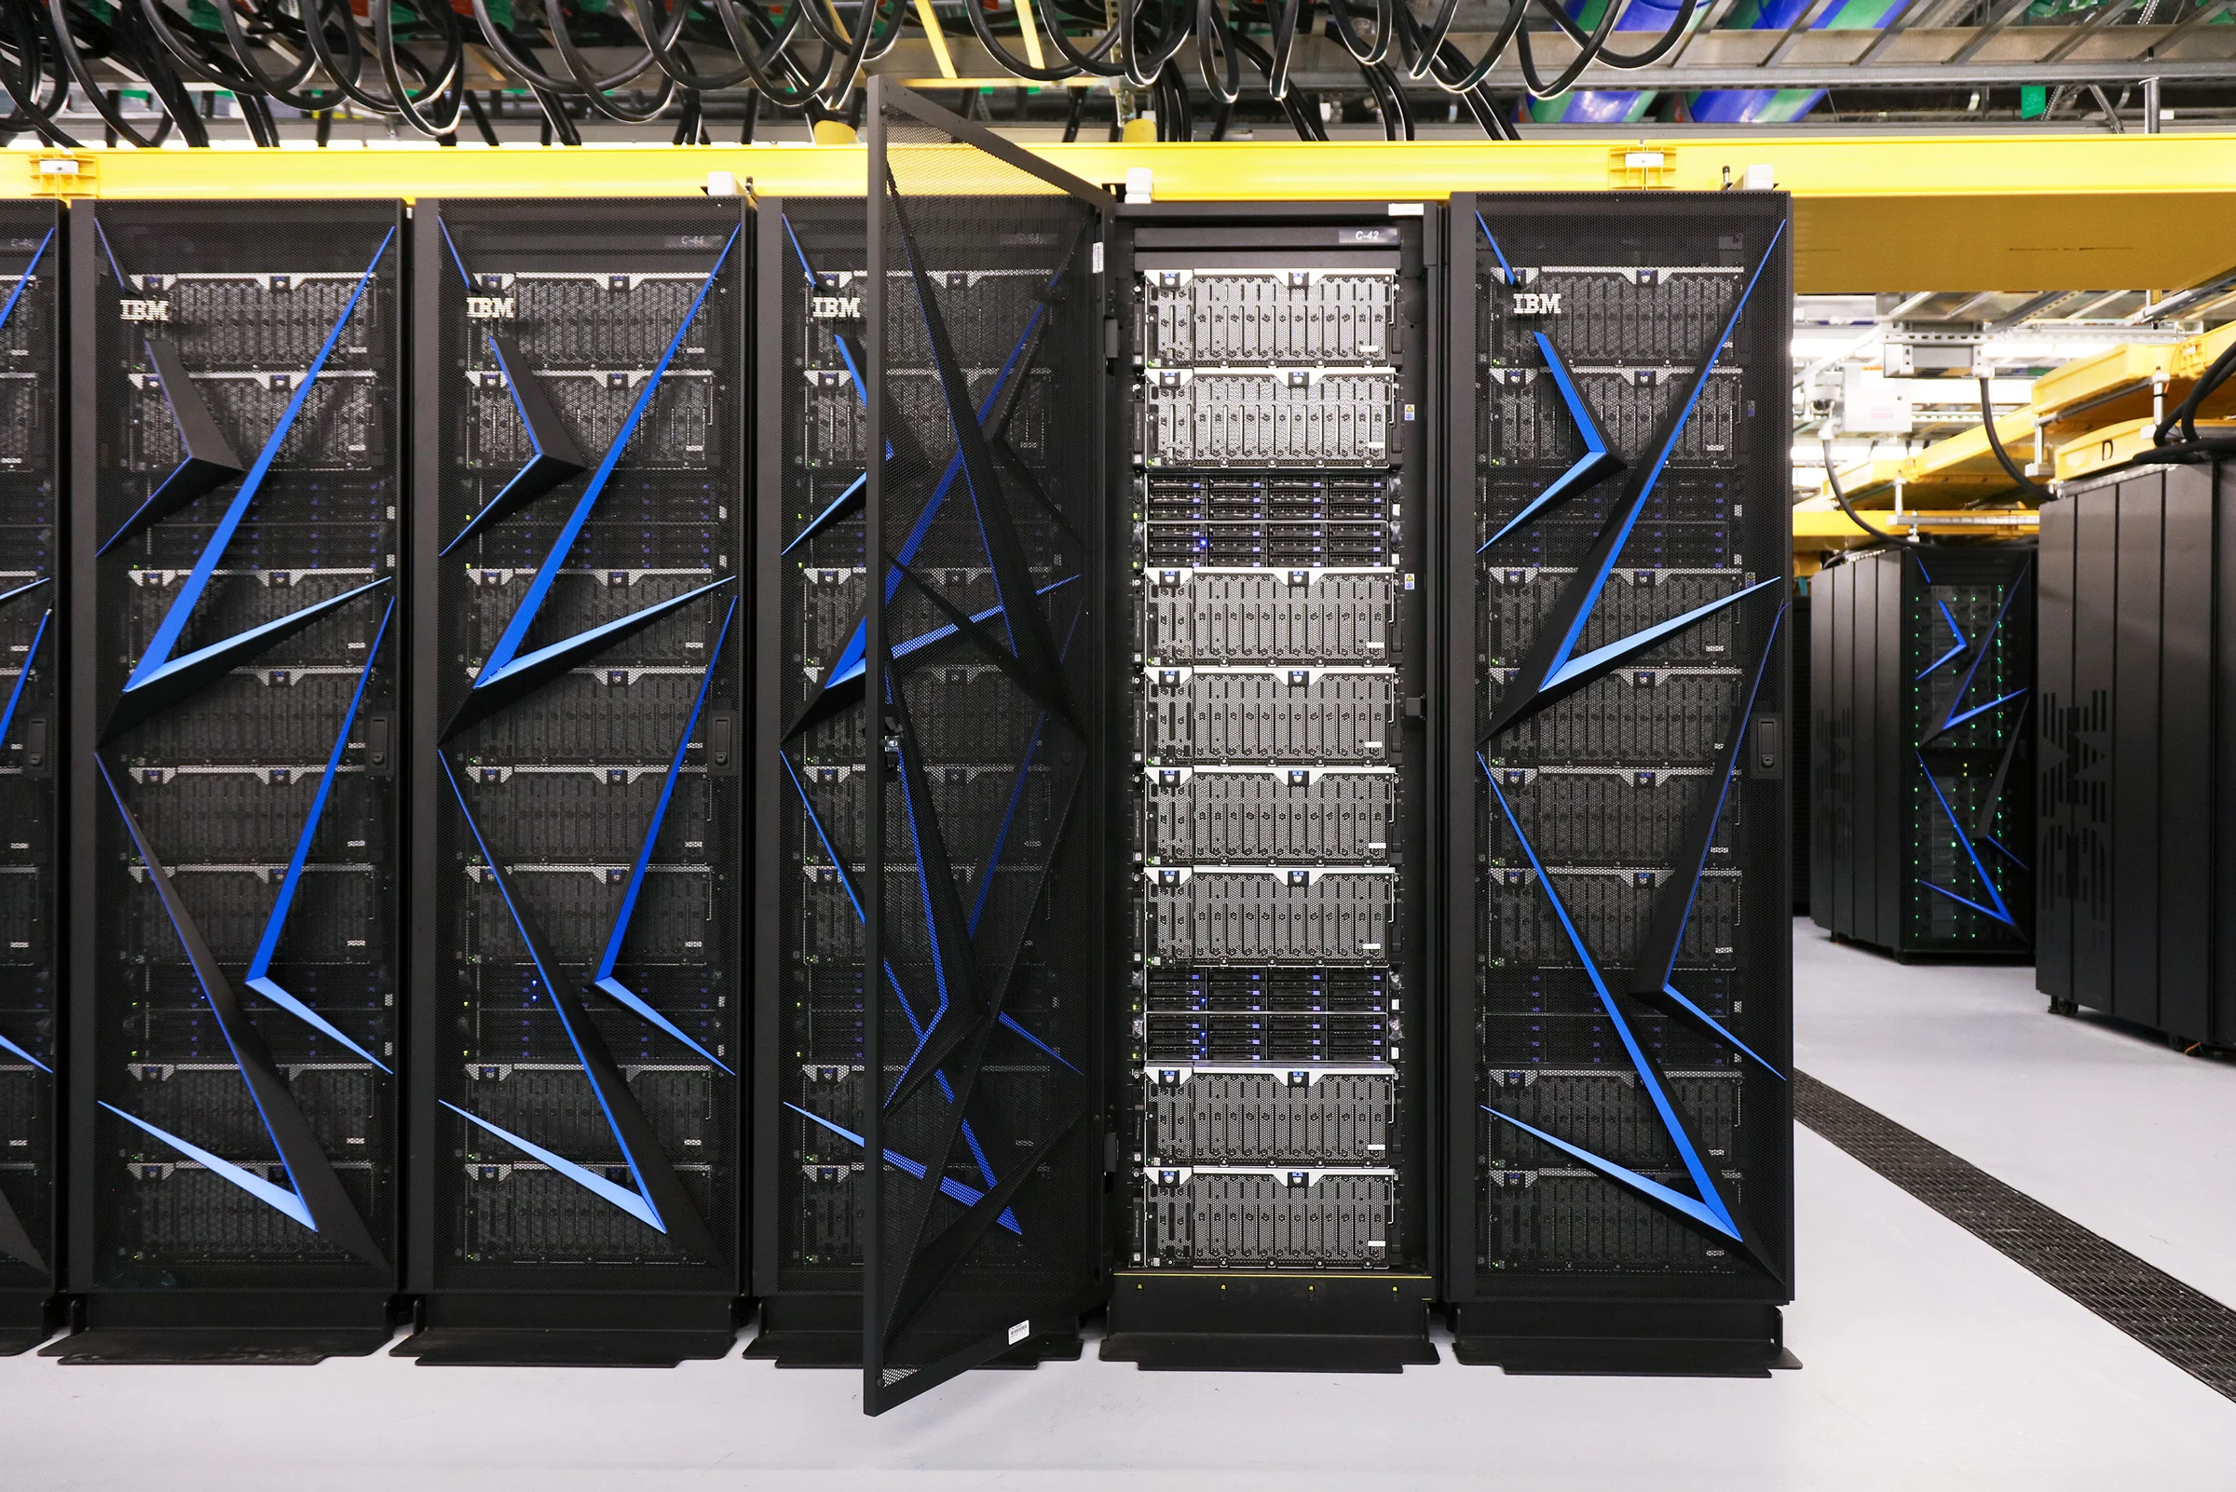
Scientific Challenges
No specific information on people doing this before
Cleaning the stock data for use in the code
Locating a sufficiently comprehensive data set
Figure 3

Slide 17
Results
Our tool successfully forms groupings of stocks based on any subsection of the market, while following user-defined timeframes and variance thresholds
Using 100 Fortune 500 [2] stocks we were able to recreate an almost identical model of the Dow Jones using the first principal component
We found that despite seemingly isolated incidents, such as the BP oil, spill, Merck Lawsuit, Aflac sudden price drop, etc. the stocks still moved together
Our portfolios found dozens of seemingly unrelated stocks with similarly timed increases and decreases in value
These relationships also held true over Economic downturns such as 2008 and 2001

Slide 18
Dow Jones Comparison

Slide 19
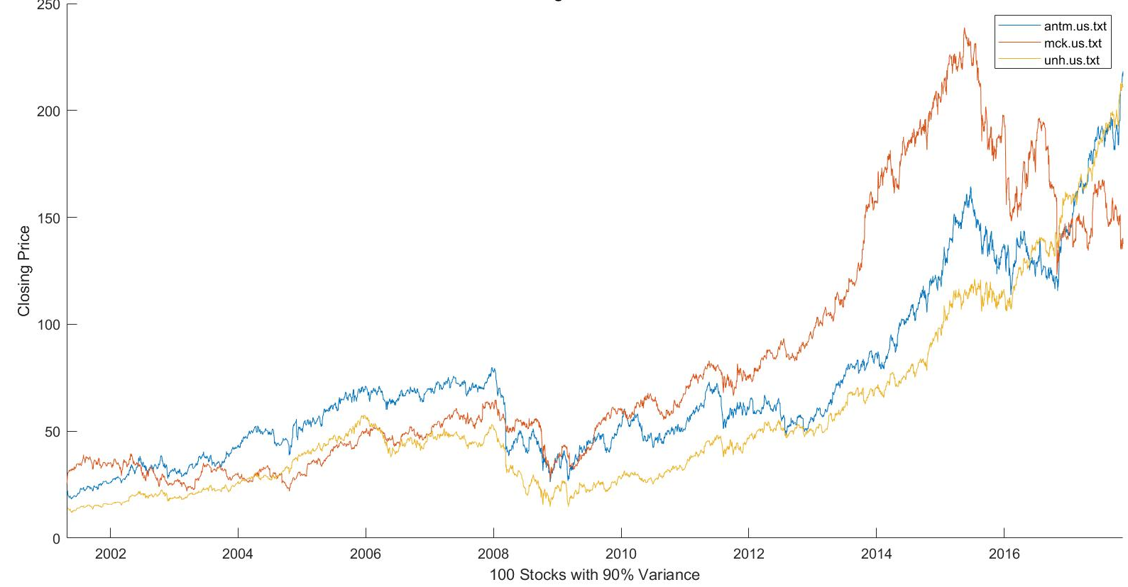
Healthcare Related Stocks
Anthem - ANTM
McKesson Corporation - MCK
UnitedHealth Group - UNH

Slide 20
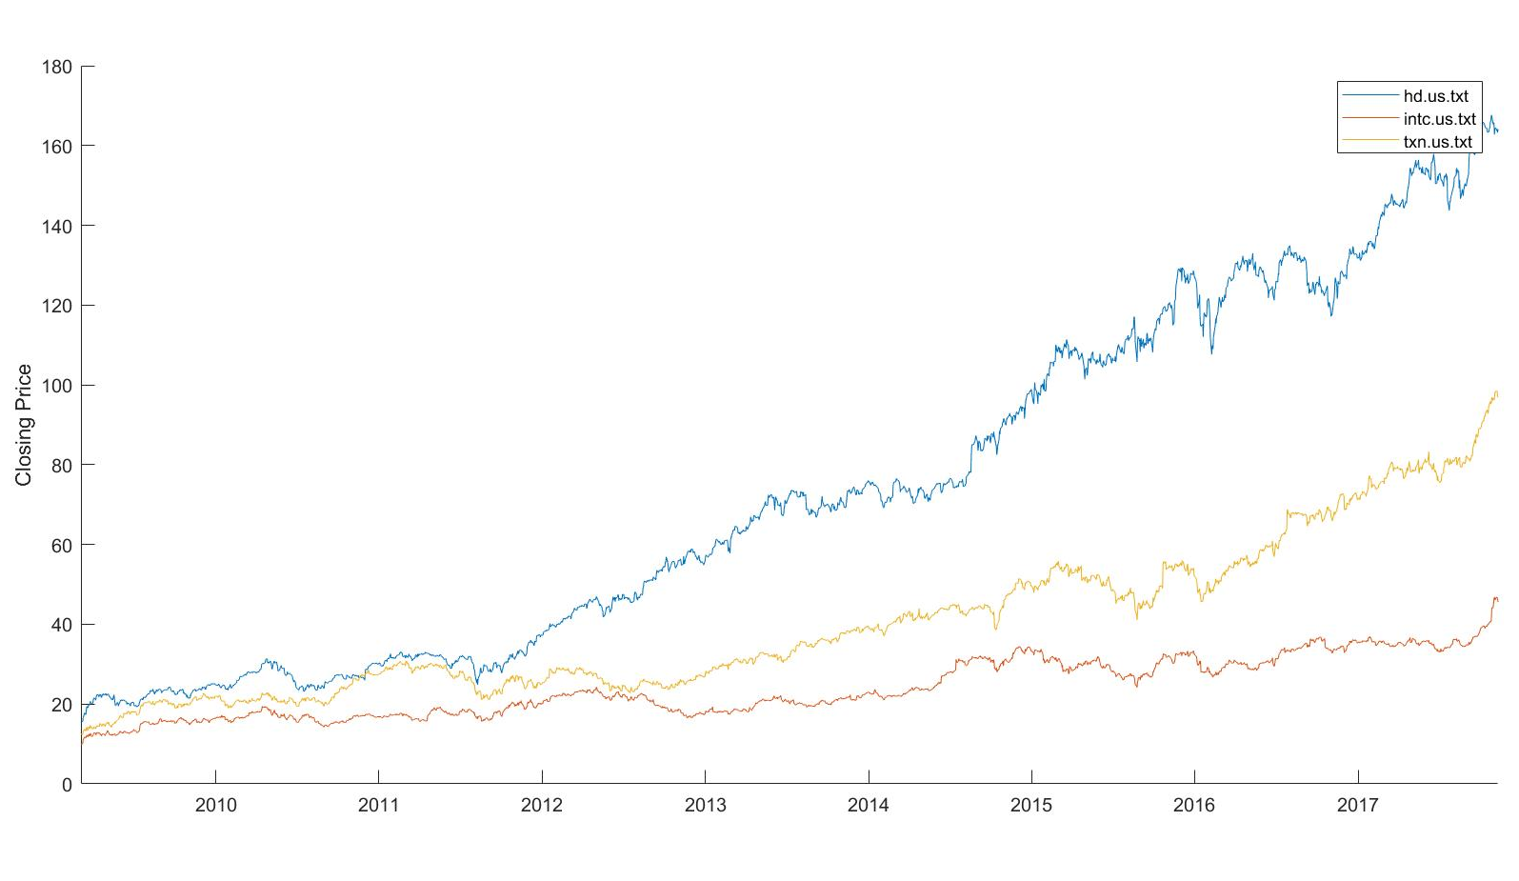
Unexpected Grouping
Home Depot - HD
Intel - INTC
Texas Instruments - TXN

Slide 21
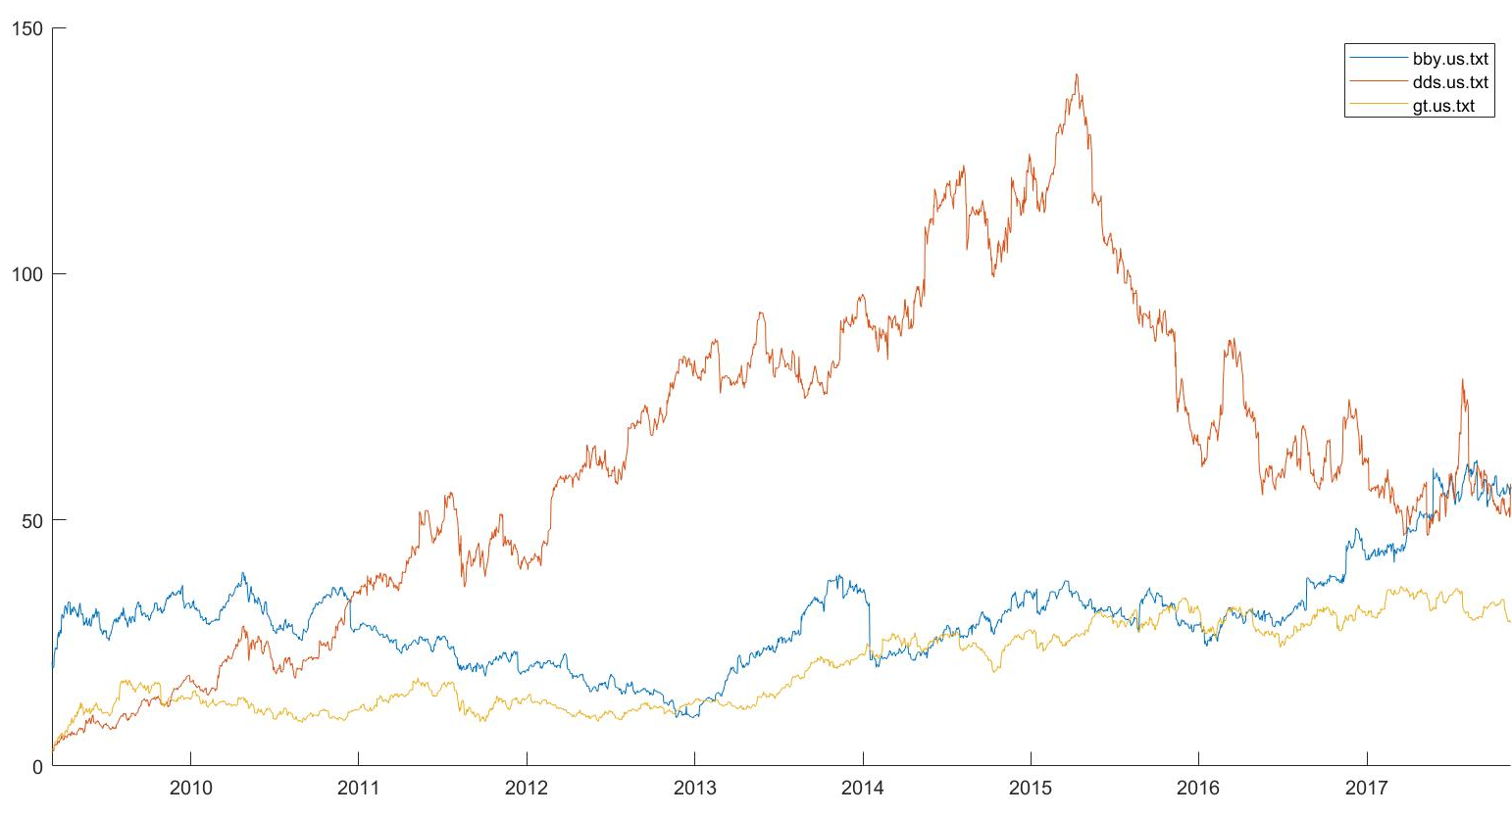
Unexpected Grouping
Best Buy - BBY
Dillards - DDS
Goodyear Tires - GT

Slide 22
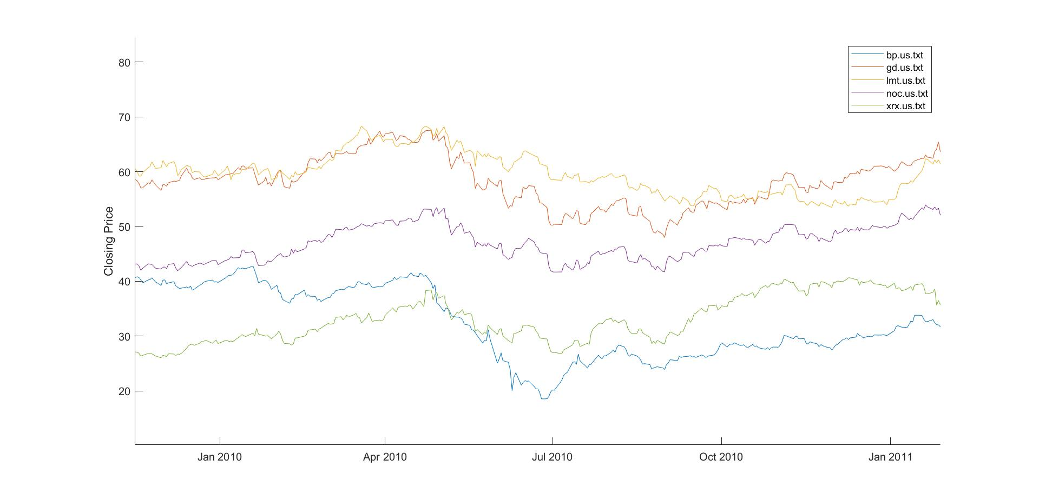
Isolated Incidents: BP Oil Spill
British Petroleum - BP
General Dynamics - GD
Lockheed - LMT
Northrop - NOC
Xerox - XRX

Slide 23
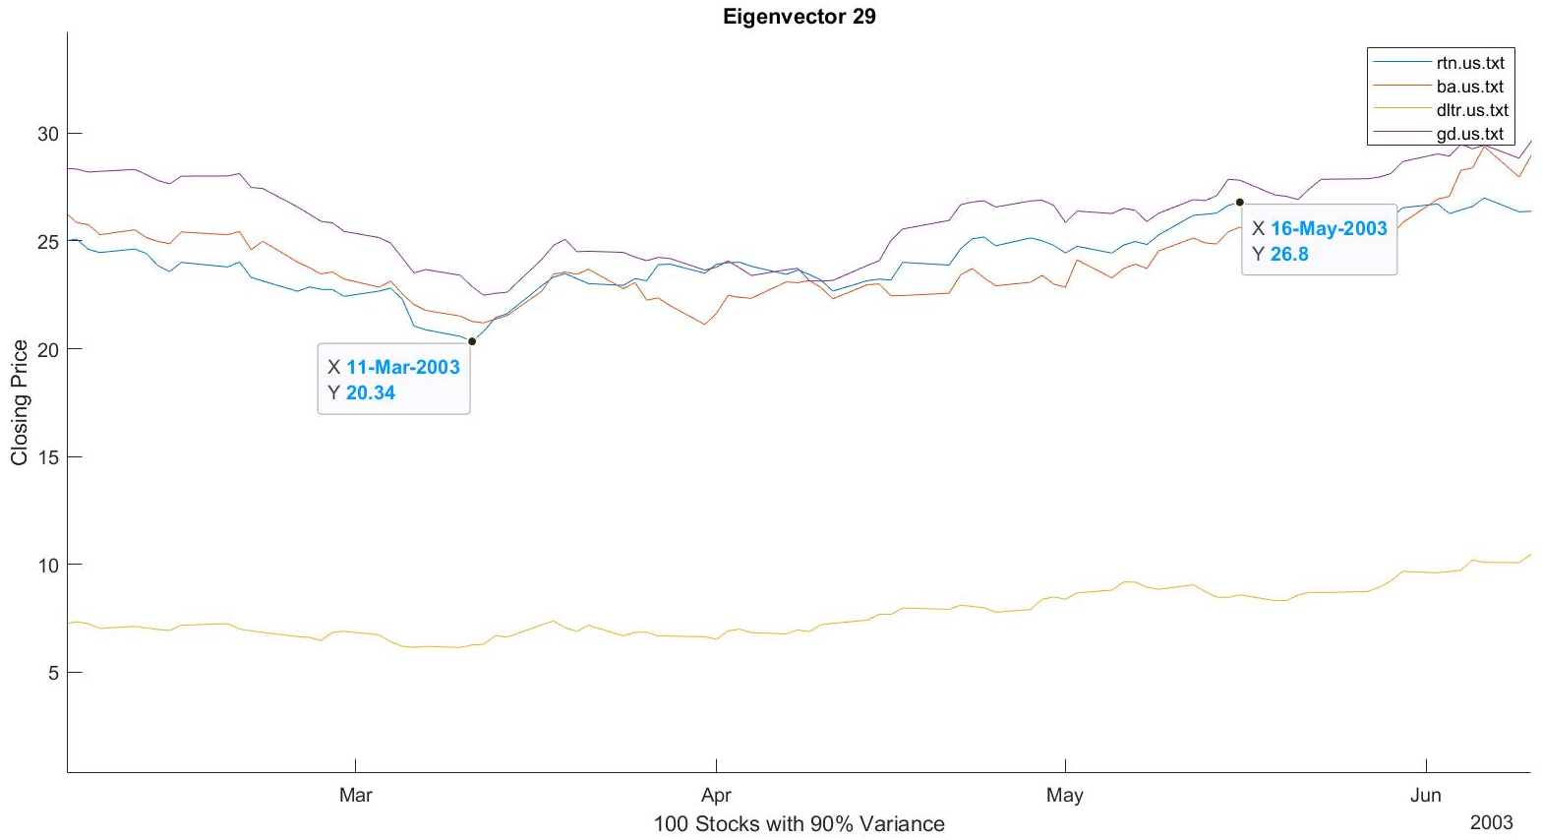
Isolated Incidents: Iraq Invasion
Raytheon - RTN
Boeing - BA
Dollar Tree - DLTR
General Dynamics - GD

Slide 24
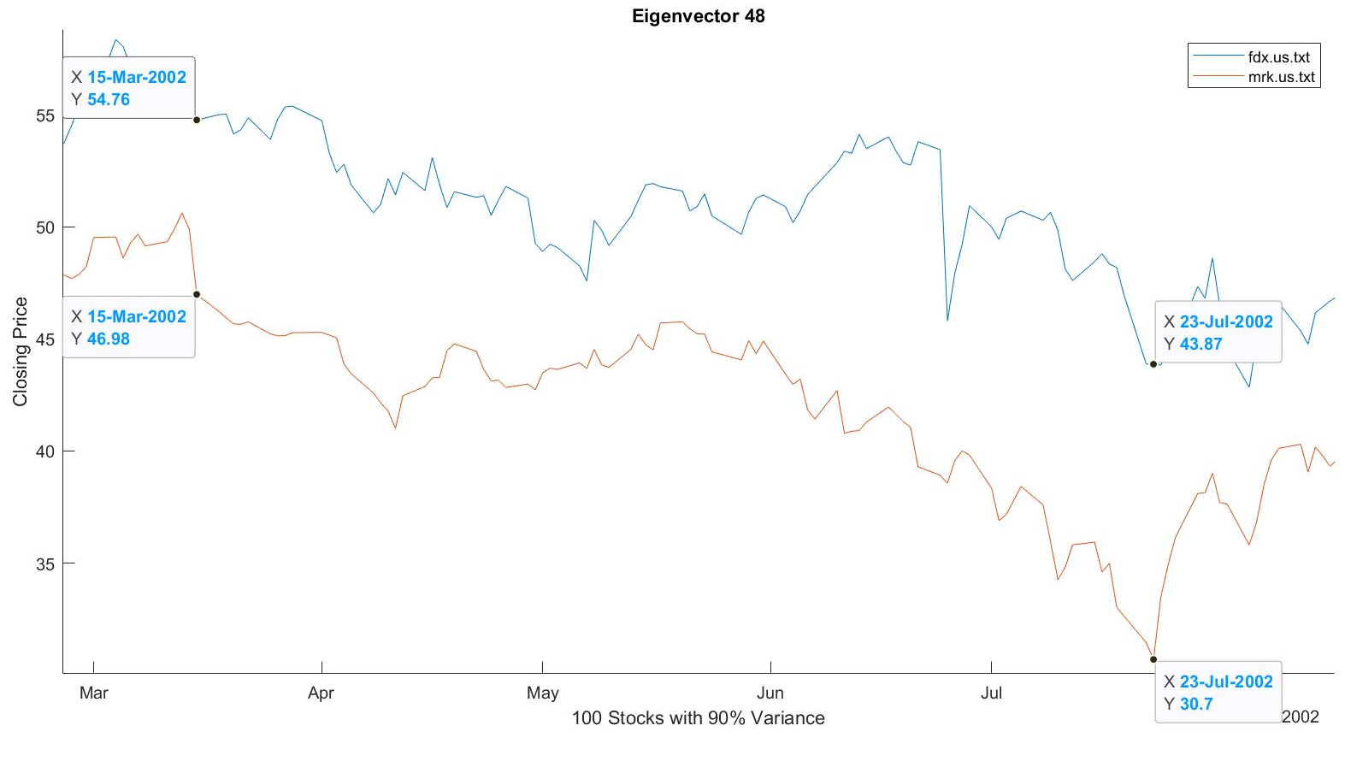
Isolated Incidents: Merck Lawsuit
FedEx - FDX
Merck - MRK

Slide 25
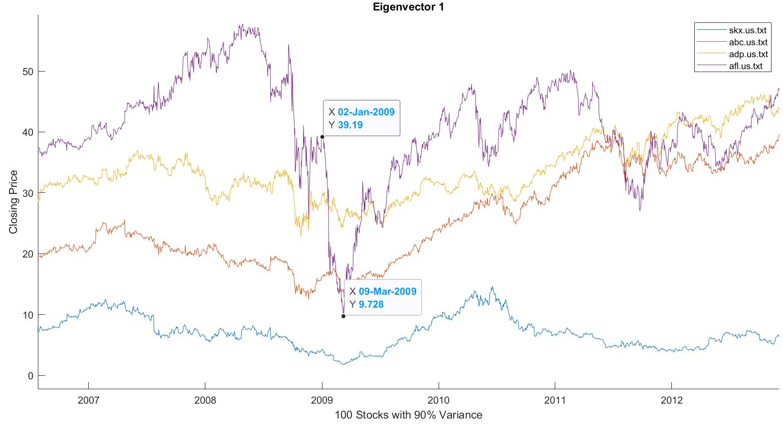
Isolated Incidents: Aflac Drop
Skechers - SKX
AmerisourceBergen - ABC
Automatic
Data Processing - ADP
Aflac - AFL

Slide 26
Potential Applications
Grouping Stocks based on their highest weighted eigenstock is a new approach to the portfolio method.

Slide 27
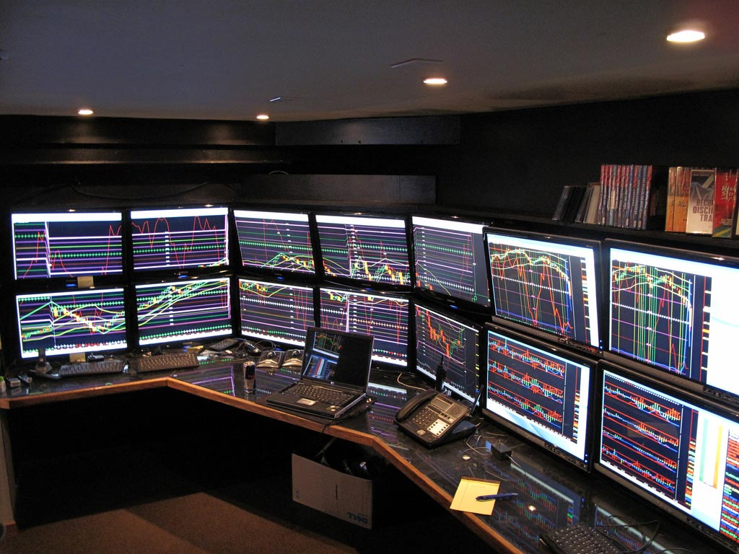
Potential Applications
Day Trading
Figure 4

Slide 28
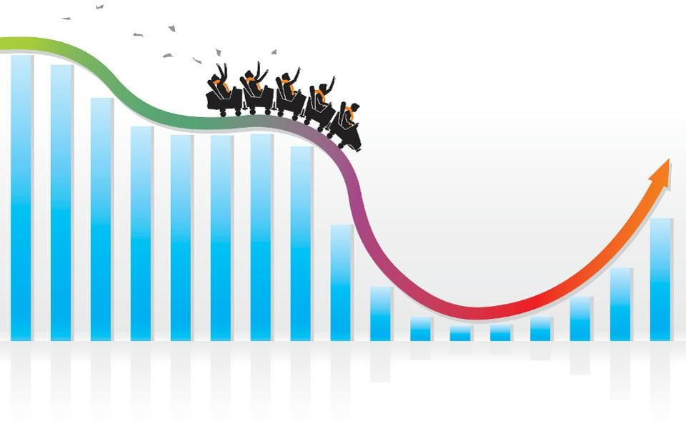
Potential Applications
Long Term investing
Figure 5

Slide 29
References
[1] Giorgia Pasini, Principal Component Analysis For Stock Portfolio Management, International Journal of Pure and Applied Mathematics, Volume 115, 153 – 168 (2017).
[2] Fortune Media. “FORTUNE.” Fortune, Fortune, 3 Apr. 2020
[3] Sheng Zhang and Matthew Turk (2008) Eigenfaces. Scholarpedia, 3(9):4244.

Slide 30
References
[4] The Ocean Portal Team. “Gulf Oil Spill.” Smithsonian Ocean, Apr. 2018
[5] Marjanovic, Boris. Huge Stock Market Dataset. Kaggle, 2017
[6] Carol Anne Hargreaves, and Chandrika Kadirvel Mani, The Selection of Winning Stocks Using Principal Component Analysis, American Journal of Marketing Research, Vol. 1, No. 3, pp. 183-188, (2015);

Slide 31
Figure References
Figure 1: Brems, Matt. “A One-Stop Shop for Principal Component Analysis.” Medium, Towards Data Science, 17 Apr. 2017, towardsdatascience.com/a-one-stop-shop-for-principal-component-analysis-5582fb7e0a9c.
Figure 2: Thomas, Philippa. “Leading without Authority: The Key to Success in a Matrix Organisation?” Training Journal, 1 July 2019, www.trainingjournal.com/articles/features/leading-without-authority-key-success-matrix-organisation.
Figure 3: Lardinois, Frederic. “IBM and the DoE Launch the World's Fastest Supercomputer.” TechCrunch, TechCrunch, 8 June 2018, techcrunch.com/2018/06/08/ibms-new-summit-supercomputer-for-the-doe-delivers-200-petaflops/.

Slide 32
Figure References
Figure 4: Admin. “2018 Is the Year to Unleash the Day Trader Within.” Men's News Daily, Admin, 9 July 2019, mensnewsdaily.com/unleash-day-trader-within/.
Figure 5: Mishuris, Gary. “How To Invest For The Long Term In A Volatile Market.” Forbes, Forbes Magazine, 15 Jan. 2019, www.forbes.com/sites/garymishuris/2019/01/15/how-to-invest-for-the-long-term-in-a-volatile-market/#3cefc7596882.

