Slide 1
The mysteries of the evolution of the Earth-Moon system
Team Members : Michael Inouye, Zack Wellington, and Kian Milani
MATH 485 Mid-Term Presentations, March 5th 2020
Dr. Gabitov, University of Arizona Department of Mathematics

Slide 2
Outline
Literature
Application Background
Goldreich Model
Touma and Wisdom Model
Summary
Future Plan
Further Reading

Slide 3
1. Literature
The articles used for this study were
History of the Lunar Orbit by Peter Goldreich 1966
Evolution of the Earth-Moon System by Jihad Touma and Jack Wisdom 1994
Proterozoic Milankovitch cycles and the history of the solar system by Stephen Meyers and Alberto Milinvernob

Slide 4
2. Application Background
The Moon’s orbit has been studied for 1000s of years and yet, until more modern times, more was known about satellites of other planets than the Moon
The mysteries of the moon revolved around the fact that the moon no longer orbits along the path of its original orbit when formed

Slide 5
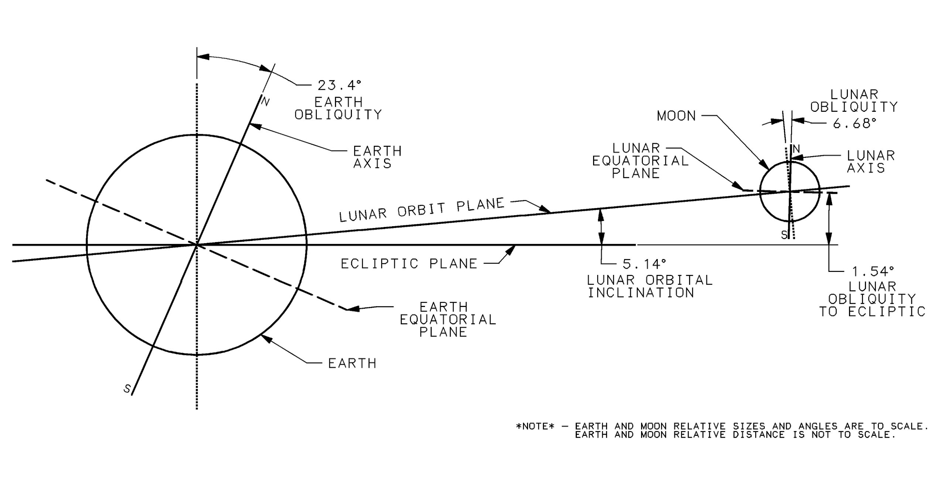
2. Application Background
Image Credit: Peter Sobchak - Own work, CC BY-SA 4.0, https://commons.wikimedia.org/w/index.php?curid=35889221

Slide 6
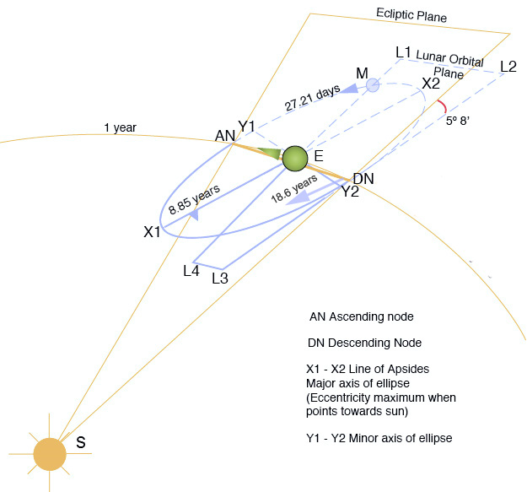
2. Application Background cont.
The Earth-Moon system is difficult to completely model due to effects from:
Other planets
Tidal friction
The sun
Imperfections in their own orbits
Any other planetary bodies
Image Credit: Geologician, Homunculus 2 - from English Wikipedia, CC BY 3.0, https://commons.wikimedia.org/w/index.php?curid=23379433

Slide 7
2. Application Background cont.
Why is this problem of interest?
Effectively modeling would allow astronomers a greater understanding of the history of the development of both the Earth and the Moon
Geologists heavily rely on these findings to help explain/measure the composition of the Earth itself, which may have implications for other areas of science
The Eocene Walvis Ridge is one of the few deep sea hotspots that stretch to the mantle of the Earth. Millions of years of sedimentation can paint an image of the evolution of tidal patterns due to the Moon’s effect on the planet..
Image Credit: Proterozoic Milankovitch cycles and the history of the solar system by Stephen Meyers and Alberto Milinvernob

Slide 8
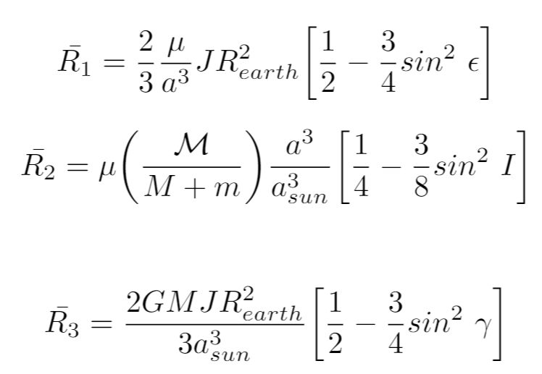
3. Goldreich Model
The first of two models that will be discussed was outlined by Goldreich in his 1966 paper:
Three time scales:
Orbital (short)
Precessional (intermediate)
Tidal (long)
Equations here are averaged disturbing potentials over the orbital time scale.

Slide 9
Variables for conserved quantities
H - scalar angular momenta of earth
h - scalar angular momenta of moon
A - component of total angular momenta normal to ecliptic
X - total potential energy of the system

Slide 10
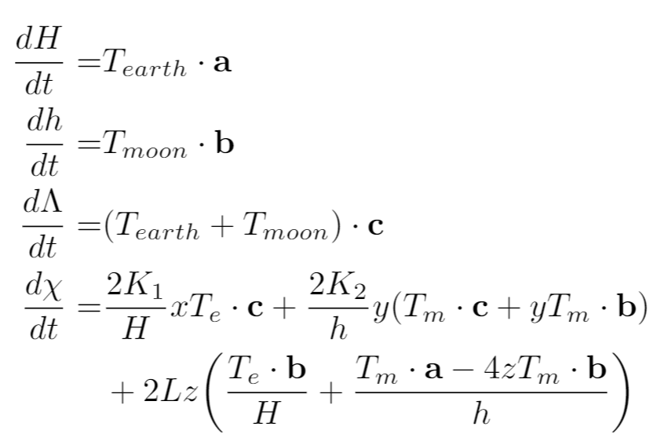
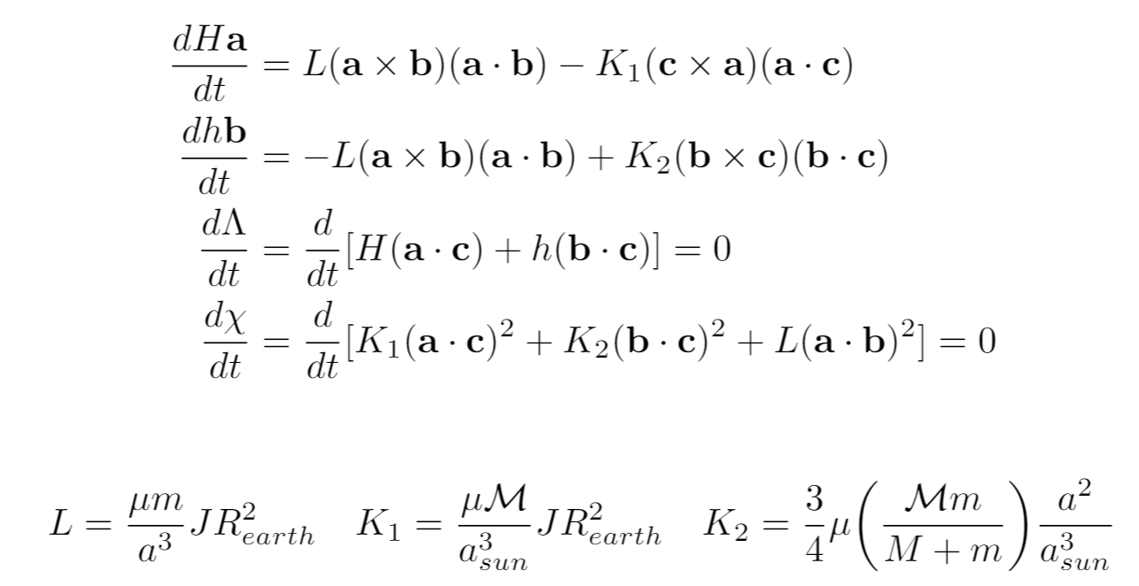
3 Goldreich Model cont.
Intermediate
Long
da/dt - rate of change of semimajor axis

Slide 11
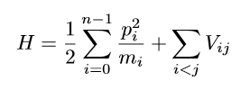
4. Touma and Wisdom Model
Touma and Wisdom in their 1994 paper expand upon Goldreich's work of the Moon-Earth system. They formulate their models using the Hamiltonian with multiple bodies:
Assumptions:
The effects of other planetary perturbations is ignored
The effect of the changing Earth-Moon orbit is ignored and is circular
The gravitational potential and the disturbance of the Sun on the system is truncated after second order terms

Slide 12
4. Touma and Wisdom Model cont.

Slide 13
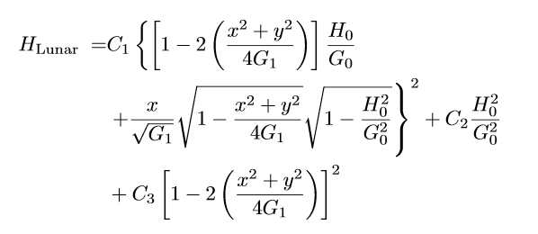
4. Touma and Wisdom Model cont.
The Hamiltonian is averaged over orbital periods to receive:
where

Slide 14
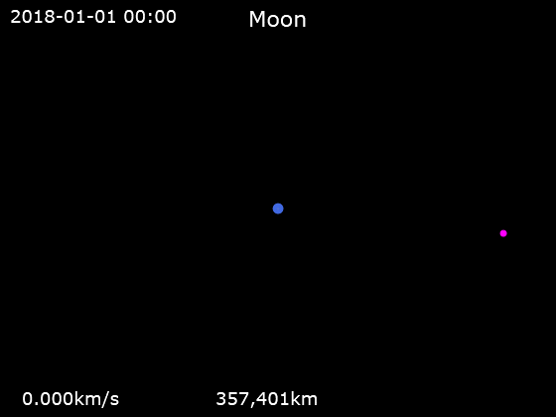
5. Summary
There are several proposed methods of effectively modeling the complexities of the Earth-Moon system.
Unfortunately, many models solved analytically make many assumptions to make the calculation feasible
Advances in numerical methods provide a great resource, these weren’t available when these models were proposed (1966, 1994)
Phoenix7777 - Own workData source: HORIZONS System, JPL, NASA, CC BY-SA 4.0, https://commons.wikimedia.org/w/index.php?curid=74066503

Slide 15
6. Future Plan
Reproduce the works and models within the Goldreich paper
Yield similar numerical results as Goldreich using Python’s ODE libraries
Second, transition to Touma and Wisdom’s environment and reproduce using numerical method
Use data offered within the Malinverno paper or from further research to validate the performance of our models
Investigate any feasible extensions or improvements that can be made to these models

Slide 16
7. Further Reading / References
History of the Lunar Orbit by Peter Goldreich
Evolution of the Earth-Moon System by Jihad Touma and Jack Wisdom
Proterozoic Milankovitch cycles and the history of the solar system by Stephen Meyers and Alberto Milinvernob
MacDonald, G. J. F. ( 1964), Tidal friction, Rev. Geophys., 2( 3), 467– 541, doi:10.1029/RG002i003p00467.
Peter Sobchak - Own work, CC BY-SA 4.0, https://commons.wikimedia.org/w/index.php?curid=35889221
Geologician, Homunculus 2 - from English Wikipedia, CC BY 3.0, https://commons.wikimedia.org/w/index.php?curid=23379433
Phoenix7777 - Own workData source: HORIZONS System, JPL, NASA, CC BY-SA 4.0, https://commons.wikimedia.org/w/index.php?curid=74066503

