Slide 1
Stability of Inverted Pendulum with Vibrating Base
Kevin Luna (Mentor)
Devin Johnson
Phillip Shelton
Zach Kirch

Slide 2
Shew Inverted Pendulum Paper
Study done at College of Wooster
Pendulum suspended on a oscillating base.
Theoretical equations and Calculations were done to predict the expected results, and then the physical setup was used to compare with their results.
Traditionally, the upward vertical pendulum position is an unstable equilibrium.
However, at certain amplitudes and frequencies of the oscillating base, this point becomes stable.

Slide 3
Theory of Inverted Pendulum
This is best understood by analyzing the Lagrange of the system.
The Lagrange is the sum of the Kinetic Energy and Potential Energy of the System, as by the Law of Motion, a system will always take the path in which the Lagrange is minimized.
Kinetic Energy:
Potential Energy:

Slide 4
Equation of Inverted Pendulum
Essentially, we convert from Cartesian Coordinate plane to Polar plane
Give us:
x = lsinθ
y = Acosωt+lcosθ
Given the fact we know the Lagrange is:
Can find the governing Second-Order ODE

Slide 5
Numerical Analysis of Simple Vibrating Pendulum
After understanding the physical properties of the inverted pendulum, writing some initial mechanical equations, and formulating the Lagrange of the problem, we are left with a single second order ODE of theta.
Parameters such as A (amplitude), l (distance away from pivot point), m (mass of object), w (frequency of pivot oscillation), and g (gravitation force) will all have to be measured for our specific system:

Slide 6
ODE Solver
We decided to use the Python language to program an ODE solver to formulate a solution for the second order differential equation.
To do this, we first isolated the second derivative term on the left hand side:

Slide 7
Python Code
We decided to use Jupyter Notebooks to code the ODE solver. The first portion looked analogous to the following:
import numpy as np # Important library for scientific computing
import matplotlib.pyplot as pp # For plotting results
from scipy.integrate import solve_ivp # Load ODE(IVP) solvers(also known as integrators)
import math # For using cosine and sine
After initializing our A, m, l, w, and g values, we then defined a function f(t,theta). Theta was a two-dimension input, as we created two ODEs from the baseline Second Order ODE to solve it.
def f(t,theta):
# note theta is our 2 dimensional input theta[0]=u and theta[1]=v
u=theta[0]
v=theta[1]
return np.array([v,-((A*l*m*(w*w)*math.cos(w*t)-m*g*l)/(I))*math.sin(u)])

Slide 8
Running ODE Solver
We then used the solve_ivp function that we obtained from importing the scipy library in Python.
We feed it a preset initial condition for (u,v) (i.e. Theta, theta dot)
Gave it an interval to integrate over, and created a corresponding grid for this range.
Used the RK45 integration method.
Output gave us an array of values that we could plot to see Theta vs. t, Theta’ vs. t, and Theta’ vs. Theta.

Slide 9
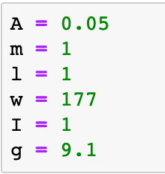
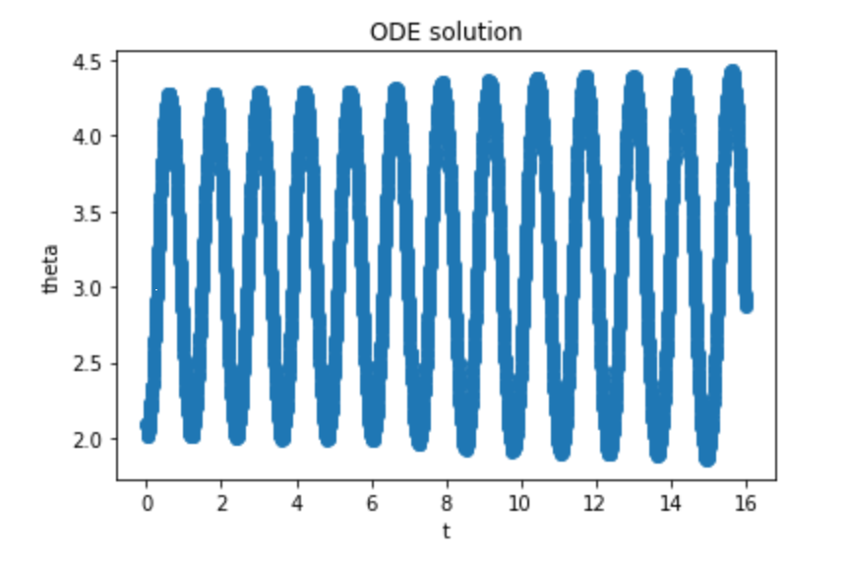
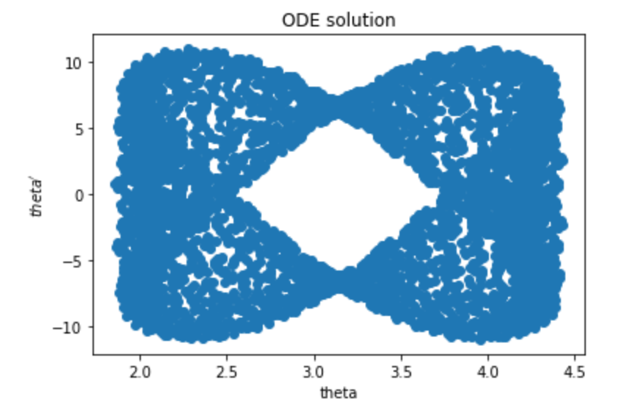
Output of the program

Slide 10
Runge-Katta
Method for solving ODEs
Iterative method which uses previous result of calculation to increase approximation accuracy
Based on Euler Method but more accurate and higher order
Used in built in functions ode45 and ode23 in MATLAB but RK23 is what we will be basing our method on as previously stated.

Slide 11
Pendulum Dynamics
Understanding pendulum physically
Need to know Moment of Inertia (Long Cylinder + mass)
Rotational forces, Axial forces, how this affects error
Rotational vs Inertial Frames
Factoring in moving base
Allows us to confirm Lagrangian and Hamiltonian computations
Method to solve using ODE is almost identical

Slide 12
Mg
theta
l
y
X

Slide 13
Stability
Bode Plots
Method to show stability about a point within a transfer function
Nyquist Plots
Another Method for showing stability and understanding transfer function usage
Transfer Function
The transfer function will act as a way to understand how to control the pendulum and if we explore variants of the vibrating base this allows us to apply it to a physical phenomenon

Slide 14
Plan for Remainder of Project
Devin Johnson: Focus on working on physical dynamic representations of the model, along with understanding a transfer function that can be used as a controller and a way to represent stability of the system. Using Bode Plots and Nyquist plots to show stability. Help with RK method and other numerical methods.
Phillip Shelton:
Zach Kirch: Focus on developing unique ODE solver that models the RK23 method (easier to code, more practical for project), use this solver for the equation that will be developed by the others, obtain plots and discuss with remainder of group to better understand what they signify

